Slide 1

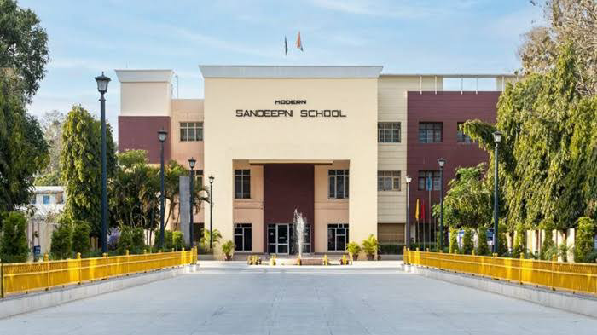
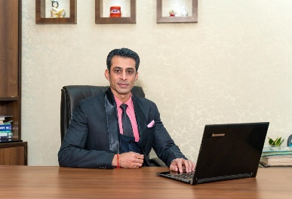
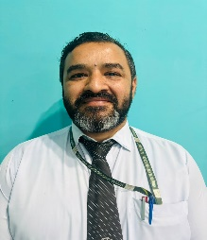
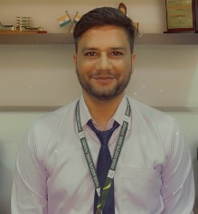
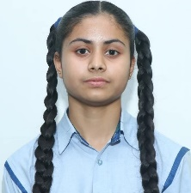
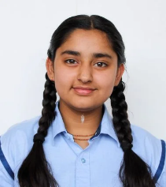
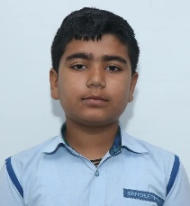
Volume: IV Issue-6
August 2025
The Sandeepni Chronicle
Editorial Team
DR. Neeraj Mohan Puri
Principal
Mr. Sushil
Editor
Mr. Vikram
Art & Design
Student Editors
Manasvi
(XI-Med)
Vaanya
(X-Peace)
Aditya Mehra
(X-Loyal)
The Sandeepni Chronicle | April 2025

Slide 2
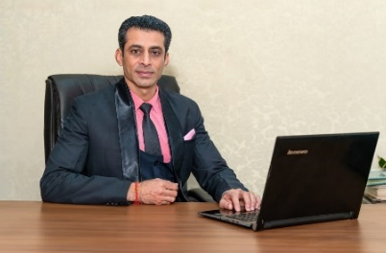
FIRST LOOK
Managing Screen Time and Digital Detox
In today’s world, screens have become an inseparable part of our lives. From online classes to entertainment, children spend hours on mobiles, tablets, and computers. While technology is a powerful tool, excessive screen time can affect health, relationships, and even creativity.
Digital detox is the conscious decision to take a break from digital devices. It helps us reconnect with ourselves, nature, and people around us. As Mahatma Gandhi said, “There is more to life than increasing its speed.” Disconnecting from screens allows us to slow down, reflect, and live mindfully.
Spending too much time on devices often leads to eye strain, disturbed sleep, and lack of focus. A student once shared how her performance improved after limiting her social media use and dedicating time to reading and outdoor play. Such small lifestyle changes bring big results.
Practical tips for managing screen time include:
Fixing a daily limit for recreational screen use.
Having “no-device zones” like dining tables and bedrooms.
Practicing hobbies like painting, gardening, or sports.
Spending quality time with family without gadgets.
“Almost everything will work again if you unplug it for a few minutes… including you.” – Anne Lamott.
By embracing digital detox, students can enjoy better concentration, creativity, and emotional well-being. Let us use technology wisely— not as a master but as a servant.
Illustrations Suggested:
A child reading under a tree.
Kids playing outdoor games.
A “no phone” sign at the dining table.
Dr. Neeraj Mohan Puri
Principal
The Sandeepni Chronicle | April 2025

Slide 3

Examination Stress: How Teachers Can Support Students Emotionally
From the Editor’s Desk
Examinations are an integral part of academic life, but for many students they become a major source of stress and anxiety. While preparation is important, emotional well-being during this phase is equally crucial. Teachers, being closest to students in their academic journey, play a significant role in helping them cope with examination stress.
Firstly, teachers can create a positive and encouraging classroom environment. Simple words of motivation, sharing success stories, or reminding students that one exam does not define their future can greatly reduce fear. Regular revision sessions, doubt-clearing classes, and providing sample questions also help students feel more confident.
Secondly, emotional support is essential. Teachers can recognize signs of stress—such as restlessness, lack of focus, or withdrawal—and guide students with relaxation techniques like deep breathing or short breaks during study hours. Encouraging balanced routines with proper sleep and healthy food can also make a difference.
Moreover, teachers should foster open communication. Allowing students to express their worries without judgment builds trust. Group discussions and peer sharing can further ease anxiety, as students realize they are not alone in their struggles.
Ultimately, the role of a teacher goes beyond academics. By being compassionate mentors and empathetic listeners, teachers can help students view examinations not as a source of fear but as an opportunity to showcase their learning. A calm mind, after all, performs far better than a stressed one.
The Sandeepni Chronicle | April 2025

Slide 4

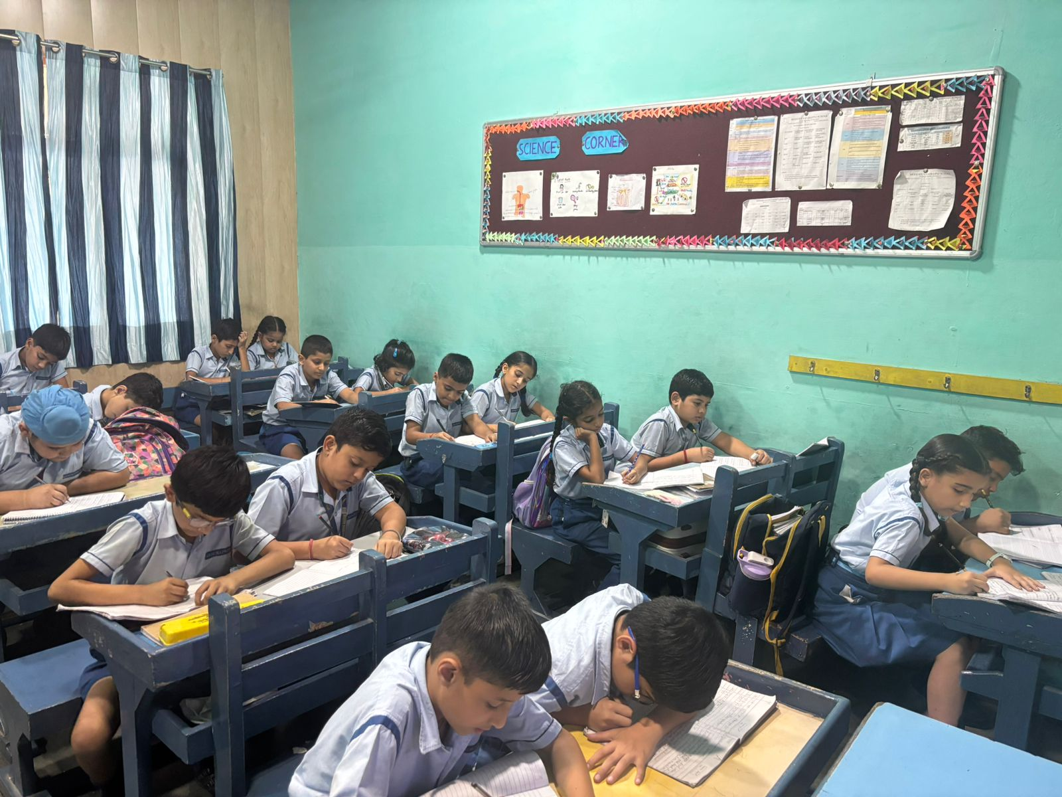
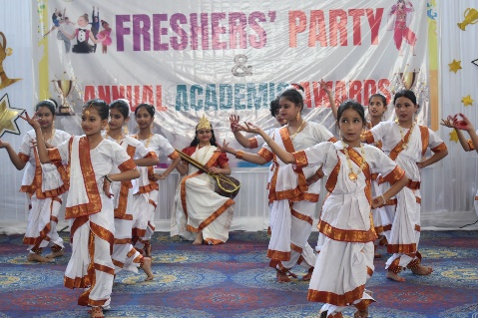
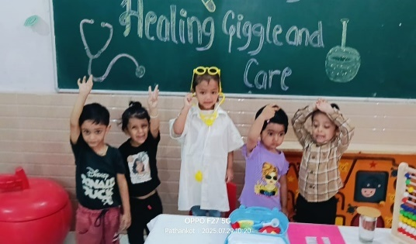

Slide 5
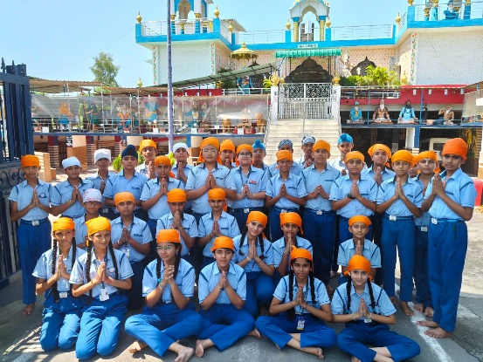
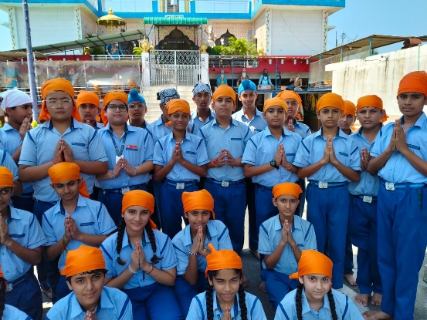
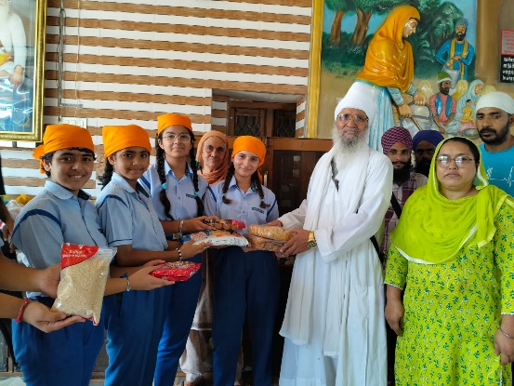
Learning Compassion through Sewa: Visit to Akalgarh Gurudwara
Article By:- Ms. Balwinder
On 21st August 2025 (Thursday), the students of Class 7th Peace visited Akalgarh Gurudwara, Dheera, Pathankot, as part of the school’s initiative to instill values of compassion, discipline, and respect among young learners.
The visit began with students and teachers arriving at the Gurudwara in the morning, where they were warmly welcomed by the sevadars. The serene environment of the holy place created a sense of peace and humility. Students participated in prayers and listened to hymns, which encouraged mindfulness and gratitude.
An important aspect of the visit was sewa (selfless service). Students helped in small tasks such as arranging footwear, serving water, and assisting in the langar hall. Through this, they learned the value of equality, as everyone in the Gurudwara shares food together irrespective of caste, creed, or status.
To support the langar, parents and students contributed dry ration items like dalia, biscuits, rice, pulses, and milk powder. This generous contribution highlighted the spirit of giving and caring for the community. Teachers guided the students in understanding how such offerings strengthen social bonds and promote empathy.
The visit concluded with a short reflection session where students shared their experiences and learnings. They expressed that the visit taught them patience, humility, and respect for all religions.
Overall, the trip was a meaningful experience, leaving students inspired to practice kindness and compassion in their daily lives.
The Sandeepni Chronicle | April 2025

Slide 6
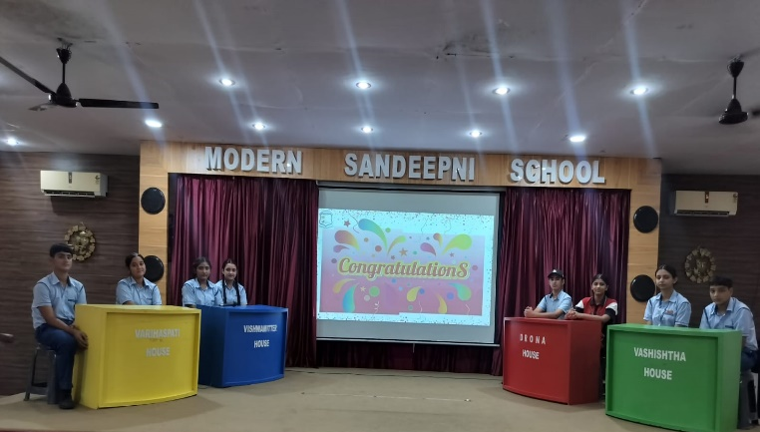
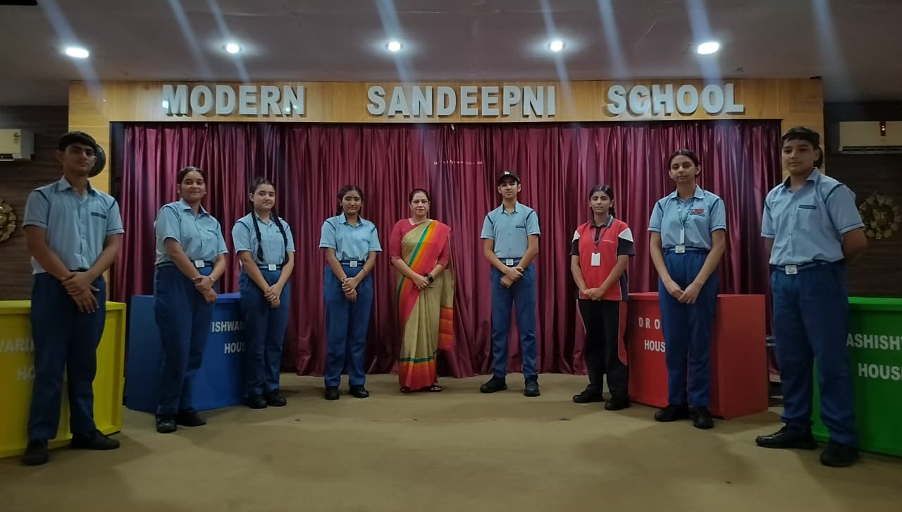
Inter-House Quiz on Environment and Forests Awareness
Article By:- Ms. Bharti
Modern Sandeepni School recently organized an engaging Inter-House Quiz Competition on Environment and Forests Awareness Program for Class IX students on 8th August 2025. This special event aims to educate and inspire students to care for nature, protect our forests, and spread awareness about environmental issues.
Through various activities and games, students not only enjoyed themselves but also helped spread important knowledge about protecting our environment and saving forests. We are proud of their efforts to learn and share valuable messages with others.
Students from all four houses will take part in various activities and games that promote learning in a fun and meaningful way. We believe this program will help students understand the importance of the environment and encourage them to take positive action. Students competed house-wise, and the event witnessed an exciting display of teamwork, quick thinking, and awareness. The final results were as follows:
1st Position: Varishaspati House
2nd Position: Vishwamitter House
3rd Position Vashishtha House
Participation: Drona House
We would like to thank our dedicated teachers—Ms Bharti for guiding and supporting the students in preparing for this event. Their efforts in organizing and motivating the children are truly appreciated
The Sandeepni Chronicle | April 2025

Slide 7
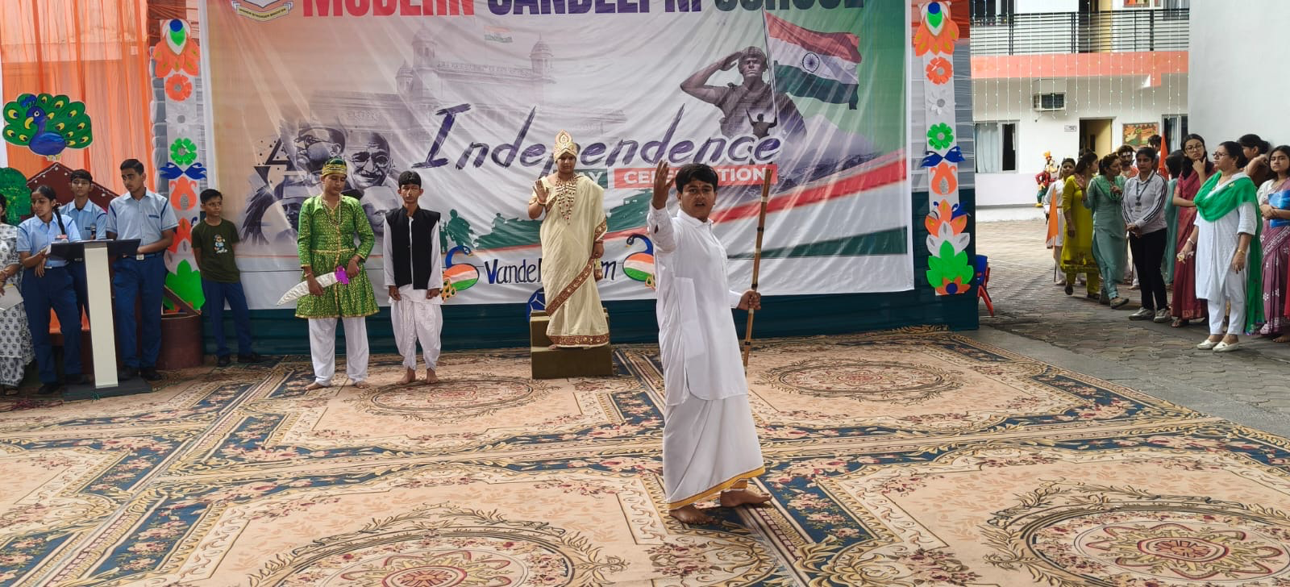
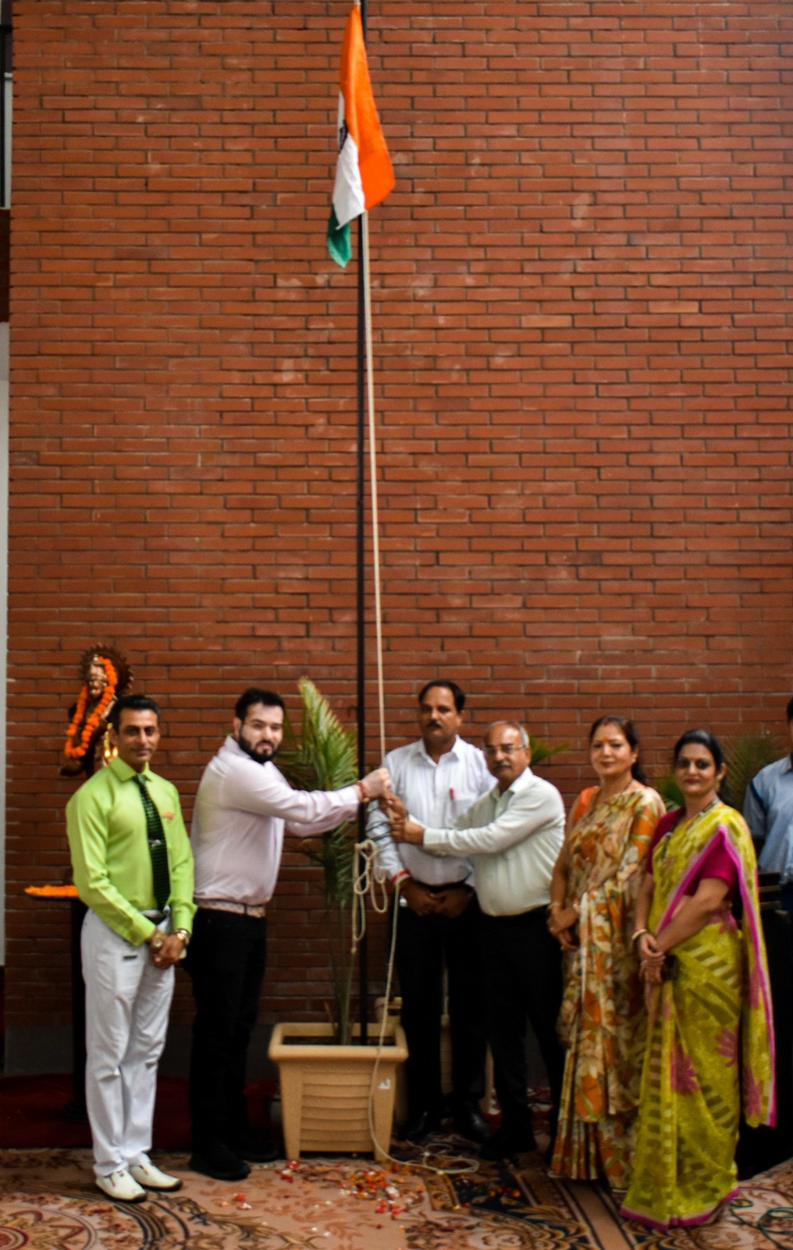
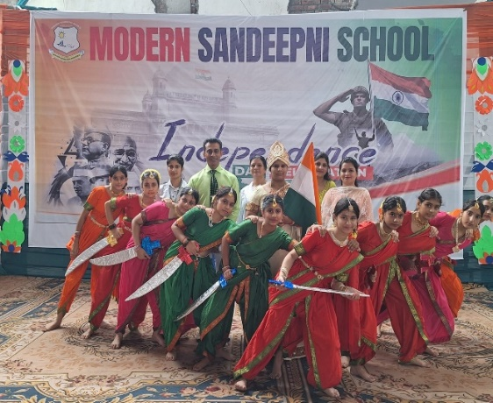
Spirit of Freedom: Independence Day Celebration
Article By:- Ms. Sonia
Modern Sandeepni School proudly celebrated the 79th Independence Day of India with great zeal and patriotic fervor. The campus was filled with the colors of the tricolour, echoing the spirit of unity and freedom. The event was graced by the distinguished presence of Principal Mr. Puri, Director Er. Pawan Mahajan, Chairman Capt. Salil Mahajan, and Manageress Mrs. Pinki Mahajan, whose support and encouragement made the day truly special.
The program began with the unfurling of the national flag, followed by the singing of the national anthem, filling every heart with pride. Students of various classes showcased their talents through patriotic dances, speeches, and activities that beautifully reflected the sacrifices of our freedom fighters and the significance of independence. Each performance resonated with the values of courage, unity, and love for the motherland.
In his motivating address, Principal Dr. Neeraj Mohan Puri reminded the students of the long struggle and sacrifices made for India’s independence. He urged them to be responsible citizens and contribute positively towards the progress of the nation. His words instilled in everyone a sense of duty and determination to uphold the values of freedom.
The celebration concluded with a vote of thanks, expressing gratitude to the management, staff, and students for their efforts in making the event a memorable one. The day truly inspired all to walk on the path of patriotism and dedicate themselves to the service of the nation.
.
The Sandeepni Chronicle | April 2025

Slide 8
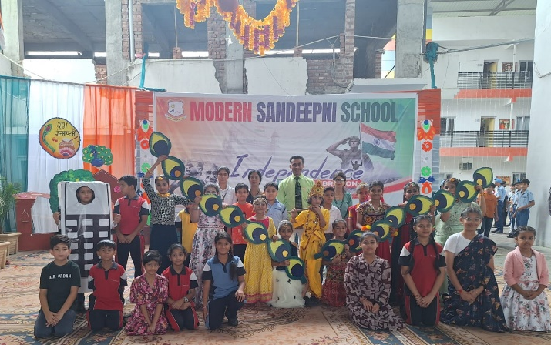
Celebrating Lord Krishna’s Teachings with Devotion and Joy
Article By:- Ms. Monica
Modern Sandeepni School celebrated the auspicious festival of Janmashtami with devotion, joy, and enthusiasm. The campus was beautifully decorated with flowers, swings, and vibrant rangolis, creating a festive atmosphere. The celebration was graced by the esteemed presence of Chairman Capt. Salil Mahajan, Director Er. Pawan Mahajan, Manageress Mrs. Pinki Mahajan, and Principal Dr. Neeraj Mohan Puri, whose guidance and encouragement made the event even more special.
The program commenced with the lighting of the ceremonial lamp, followed by a variety of cultural performances by the students. The highlight of the day was a spectacular act presented by the Kindergarten wing, where the little ones showcased the life journey of Lord Krishna—from his birth in the prison to his playful childhood in Gokul. Their performance won the hearts of the audience with its innocence and devotion.
Students from different classes also presented dances, songs, and speeches, filling the atmosphere with divine energy and devotion. Each act reflected the values of love, righteousness, and truth, which Lord Krishna stood for.
In his inspiring address, Honorable Director Er. Pawan Mahajan enlightened the students about the significance of Janmashtami and the teachings of Lord Krishna. He emphasized the importance of truth, duty, and righteousness in our daily lives, urging students to follow the noble path shown by Lord Krishna.
The celebration concluded with applause and blessings, leaving behind a message of faith, unity, and devotion in every heart.
The Sandeepni Chronicle | April 2025

Slide 9
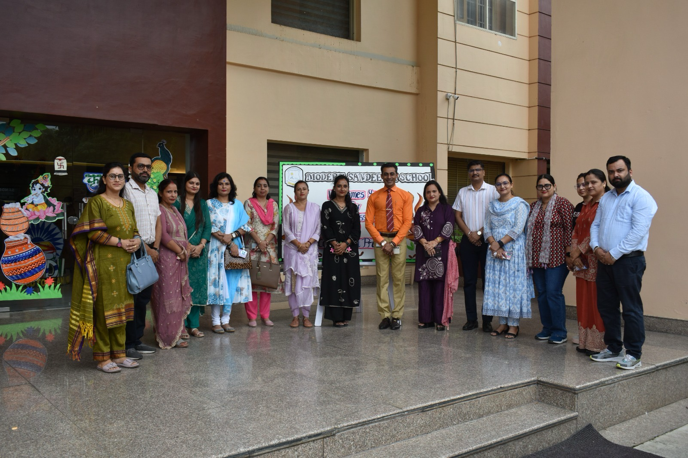
Coffee with the Principal: A Blend of Patriotism and Devotion
Article By:- Mr. Shilpa Sharma
On August 18, 2025 (Monday), Modern Sandeepni School organized a special session of “Coffee with the Principal” for the students of Grade 3, with the theme “Celebration of Independence Day & Janmashtami.” The program beautifully combined patriotism with devotion, creating a meaningful experience for the young learners.
The assembly began with a soulful prayer and invocation, setting a spiritual tone for the morning. This was followed by the Thought of the Day, which reflected on freedom, patriotism, and Lord Krishna’s teachings, inspiring students to value both their nation and their cultural heritage.
A serene Shloka Recitation from the Bhagavad Gita filled the atmosphere with divinity. Soon after, a young student delivered a speech on Independence Day, highlighting the significance of freedom and the sacrifices of our great leaders.
The Gita Vichar segment offered a simple yet powerful explanation of a verse from the Bhagavad Gita, helping children understand its relevance in daily life.
The cultural segment began with a vibrant patriotic dance by the boys, which reflected love and respect for the nation. This was followed by a graceful Radha–Krishna dance by the girls, beautifully depicting the joy, devotion, and divine bond of Janmashtami.
Principal Dr. Neeraj Mohan Puri then addressed the gathering, delivering an inspiring message on the values of freedom, unity, and devotion. He encouraged students to cherish their independence, stay rooted in cultural values, and grow into responsible citizens.
The program concluded with the National Anthem, sung with pride and reverence by all present. The event was a perfect blend of learning, culture, and celebration, leaving behind a message of patriotism and faith in every heart.
The Sandeepni Chronicle | April 2025

Slide 10
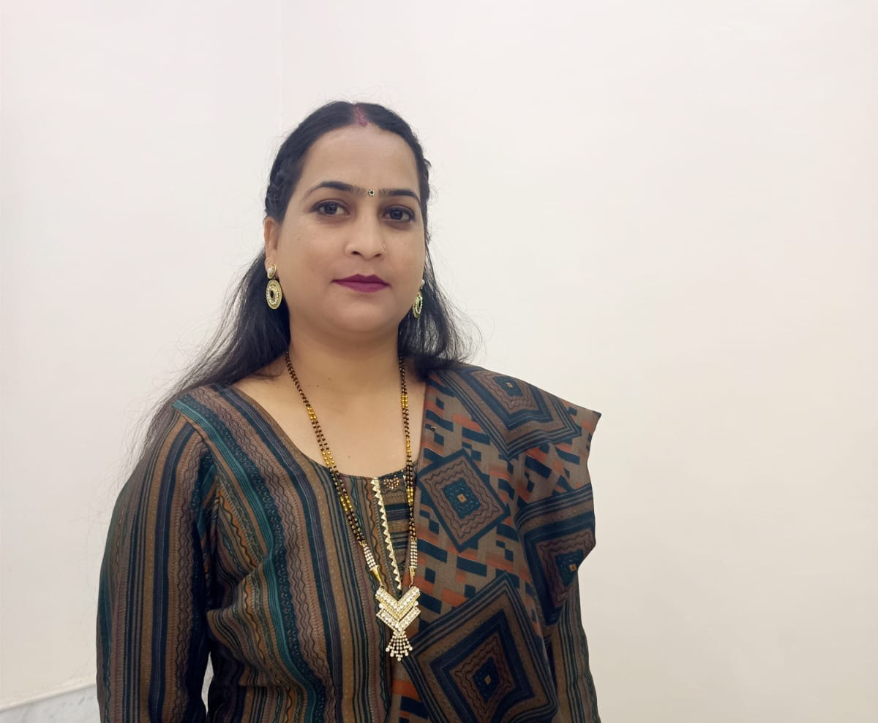
Parent’s Pen
Importance of Routine in a Child’s Life
In today’s fast-paced world, parenting can sometimes feel like a race against time. Between school routines, screen distractions, and busy work schedules, the art of patient parenting often takes a back seat. Yet, it is patience that lays the foundation for a lifelong bond of trust, love, and understanding between parents and children.
Patience in parenting doesn’t mean letting go of discipline or giving in to every demand. Instead, it’s about responding with calm instead of reacting with frustration. Children, especially in their formative years, are still learning to regulate their emotions, understand consequences, and express themselves. A patient parent becomes a safe space—someone who listens more, guides gently, and corrects without criticism.
Practicing patience teaches children that mistakes are part of learning, and home is a place where they’re accepted for who they are. This strengthens their self-esteem and encourages open communication. When a child knows they won’t be judged harshly, they’re more likely to share their fears, failures, and dreams.
To build this kind of relationship, parents can adopt simple yet powerful habits:
Pause before reacting.
Get down to the child’s eye level while talking.
Use positive language.
Avoid comparisons and harsh labels.
Celebrate small efforts, not just outcomes.
Remember, children don’t need perfect parents—they need present and patient ones. In being patient, you’re not only raising a calm and confident child but also nurturing a deeper, lasting connection that will carry your relationship through every stage of life.
Let’s slow down, breathe, and parent with patience—because strong bonds aren’t built in a moment; they’re built over time
Neelam
Proud Parent of Aditya Mehra Grade X-Loyal
The Sandeepni Chronicle | April 2025

Slide 11


Slide 12
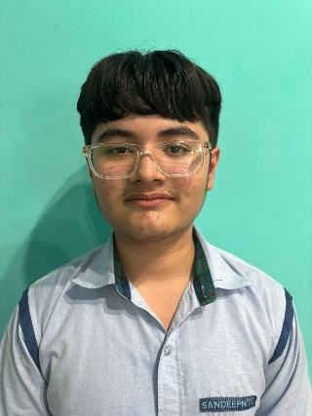
Book Review
Metamorphosis by Franz Kafka
Reviewed by:-Hardik (X-Peace)
Franz Kafka’s Metamorphosis is a haunting and thought-provoking novella that explores themes of alienation, identity, and the absurdity of human existence. The story begins with an iconic and surreal moment: Gregor Samsa, a traveling salesman, wakes up to find himself transformed into a giant insect. This shocking transformation is not treated with horror by his family but rather with embarrassment and discomfort, revealing the cold and conditional nature of human relationships.
Kafka’s minimalist yet powerful prose delves deep into Gregor’s psychological deterioration as he becomes more isolated and unwanted in his own home. What makes the story powerful is not the fantastical event itself, but how ordinary and cruel the reactions to it are. Gregor, once the provider, is quickly reduced to a burden—highlighting how human worth is often tied to productivity.
The novella is a sharp critique of modern society, especially the dehumanizing effects of work and family expectations. Despite its brief length, Metamorphosis leaves a lasting impact through its vivid imagery and unsettling message. Kafka masterfully blurs the line between the bizarre and the mundane, making Metamorphosis a timeless classic that continues to challenge and disturb readers around the world.
The Sandeepni Chronicle | April 2025

Slide 13
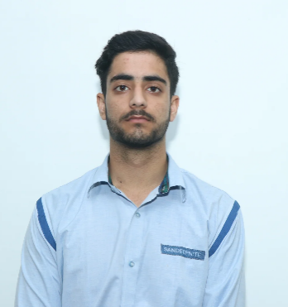
The Power of Discipline in Student Life
By:- Mir Sarwar (XI- Commerce)
Discipline is one of the most valuable qualities in a student’s life. It acts as a guiding force that helps students focus on their goals and achieve success. A disciplined student is always punctual, responsible, and committed to hard work, which ultimately leads to personal growth and academic excellence.
Discipline teaches the importance of time management. Students who follow a daily routine are able to balance studies, play, and rest effectively. It also instills self-control, helping them avoid distractions and remain dedicated to their tasks. With discipline, even difficult subjects and challenges can be overcome with patience and consistent effort.
Moreover, discipline builds character. It develops honesty, respect for others, and a positive attitude toward life. Whether it is completing homework on time, obeying school rules, or preparing sincerely for examinations, discipline ensures steady progress.
In the long run, disciplined habits formed during student life become the foundation of a successful future. As the saying goes, “Discipline is the bridge between goals and achievement.”
Therefore, students must embrace discipline not as a burden but as a path to success, confidence, and a bright tomorrow.
The Sandeepni Chronicle | April 2025

Slide 14
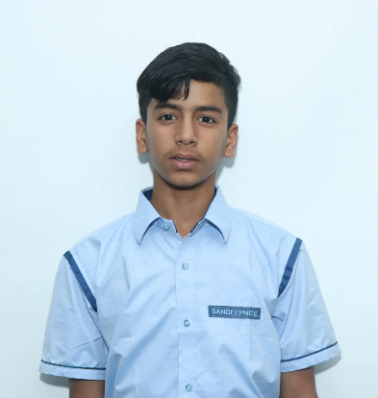
पर्यावरण संरक्षण : हमारी जिम्मेदारी
By:- Laksh ( XII- Humanities)
आज के आधुनिक युग में पर्यावरण प्रदूषण सबसे बड़ी समस्या बनकर सामने आ रहा है। पेड़ों की कटाई, औद्योगिक धुएँ, प्लास्टिक का अत्यधिक प्रयोग और प्राकृतिक संसाधनों का दुरुपयोग हमारे जीवन और भविष्य दोनों के लिए खतरा है। ऐसे समय में पर्यावरण संरक्षण केवल सरकार या संस्थाओं की जिम्मेदारी नहीं है, बल्कि यह हर नागरिक का कर्तव्य है।
हम सबको मिलकर यह सुनिश्चित करना चाहिए कि हम अपने आसपास स्वच्छता बनाए रखें। पेड़ लगाना, जल की बर्बादी रोकना और प्लास्टिक के उपयोग को कम करना हमारी पहली प्राथमिकता होनी चाहिए। यदि हर परिवार एक पौधा लगाए और उसकी देखभाल करे तो यह आने वाली पीढ़ियों को स्वच्छ वायु और हरियाली उपहार में देगा।
स्कूल और कॉलेज के छात्रों को भी पर्यावरण संरक्षण के प्रति जागरूक होना चाहिए। छोटी-छोटी आदतें, जैसे बिजली बचाना, पानी की टंकी से रिसाव रोकना, पुन: प्रयोग योग्य वस्तुओं का उपयोग करना और कचरे को अलग-अलग डिब्बों में डालना, हमारे पर्यावरण को सुरक्षित बना सकती हैं।
हमें यह याद रखना होगा कि धरती केवल हमारी नहीं है, बल्कि आने वाली पीढ़ियों की भी धरोहर है। यदि हमने समय रहते कदम नहीं उठाए तो हमें गंभीर परिणामों का सामना करना पड़ेगा।
इसलिए, पर्यावरण की रक्षा करना हम सबकी सामूहिक जिम्मेदारी है। स्वच्छ और सुरक्षित पर्यावरण ही स्वस्थ और खुशहाल जीवन की नींव है।
The Sandeepni Chronicle | April 2025

Slide 15

ਕੰਪਿਊਟਰ ਯੁੱਗ ਵਿਚ ਸਿੱਖਿਆ ਦੀ ਅਹਿਮੀਅਤ
By:- Nishika Katoch (X-Loyal)
ਅੱਜ ਦੇ ਸਮੇਂ ਨੂੰ ਕੰਪਿਊਟਰ ਯੁੱਗ ਕਿਹਾ ਜਾਂਦਾ ਹੈ। ਜਿਵੇਂ ਜਿਵੇਂ ਤਕਨਾਲੋਜੀ ਨੇ ਵਿਕਾਸ ਕੀਤਾ ਹੈ, ਸਿੱਖਿਆ ਦੇ ਖੇਤਰ ਵਿੱਚ ਵੀ ਵੱਡੇ ਬਦਲਾਅ ਆਏ ਹਨ। ਅੱਜ ਸਿੱਖਿਆ ਸਿਰਫ਼ ਕਿਤਾਬਾਂ ਤੱਕ ਸੀਮਤ ਨਹੀਂ ਰਹੀ, ਬਲਕਿ ਡਿਜ਼ਿਟਲ ਸਾਧਨਾਂ ਰਾਹੀਂ ਬਹੁਤ ਆਸਾਨ ਅਤੇ ਰੁਚਿਕਰ ਬਣ ਗਈ ਹੈ।
ਕੰਪਿਊਟਰ ਅਤੇ ਇੰਟਰਨੈੱਟ ਨੇ ਸਿੱਖਣ ਦੇ ਤਰੀਕਿਆਂ ਨੂੰ ਬਦਲ ਕੇ ਰੱਖ ਦਿੱਤਾ ਹੈ। ਆਨਲਾਈਨ ਕਲਾਸਾਂ, ਸਮਾਰਟ ਕਲਾਸਰੂਮ ਅਤੇ ਡਿਜ਼ਿਟਲ ਲਾਇਬ੍ਰੇਰੀਆਂ ਨੇ ਵਿਦਿਆਰਥੀਆਂ ਲਈ ਗਿਆਨ ਦੇ ਨਵੇਂ ਦਰਵਾਜ਼ੇ ਖੋਲ੍ਹੇ ਹਨ। ਹੁਣ ਵਿਦਿਆਰਥੀ ਕਿਸੇ ਵੀ ਵਿਸ਼ੇ ਬਾਰੇ ਜਾਣਕਾਰੀ ਕੁਝ ਮਿੰਟਾਂ ਵਿੱਚ ਪ੍ਰਾਪਤ ਕਰ ਸਕਦੇ ਹਨ। ਇਸ ਨਾਲ ਸਮਾਂ ਵੀ ਬਚਦਾ ਹੈ ਅਤੇ ਸਿੱਖਣ ਦੀ ਲਗਨ ਵੀ ਵਧਦੀ ਹੈ।
ਇਸ ਯੁੱਗ ਵਿੱਚ ਕੰਪਿਊਟਰ ਗਿਆਨ ਬਹੁਤ ਜ਼ਰੂਰੀ ਹੋ ਗਿਆ ਹੈ। ਕੰਪਿਊਟਰ ਦੀ ਮਦਦ ਨਾਲ ਨਾ ਸਿਰਫ਼ ਵਿਦਿਆਰਥੀ ਆਪਣੀਆਂ ਪੜ੍ਹਾਈਆਂ ਵਿੱਚ ਤਰੱਕੀ ਕਰ ਸਕਦੇ ਹਨ, ਬਲਕਿ ਉਹ ਰਚਨਾਤਮਕਤਾ ਅਤੇ ਖੋਜੀ ਸੋਚ ਨੂੰ ਵੀ ਵਿਕਸਤ ਕਰਦੇ ਹਨ। ਪ੍ਰੇਜ਼ੈਂਟੇਸ਼ਨ ਤਿਆਰ ਕਰਨਾ, ਗ੍ਰਾਫ਼ ਬਣਾਉਣਾ, ਡਾਟਾ ਇਕੱਠਾ ਕਰਨਾ ਅਤੇ ਪ੍ਰੋਗਰਾਮਿੰਗ ਜਿਹੀਆਂ ਕਲਾ-ਕੌਸ਼ਲਾਂ ਵਿਦਿਆਰਥੀਆਂ ਨੂੰ ਭਵਿੱਖ ਲਈ ਤਿਆਰ ਕਰਦੀਆਂ ਹਨ।
ਇਸ ਤੋਂ ਇਲਾਵਾ, ਕੰਪਿਊਟਰ ਰਾਹੀਂ ਵਿਦਿਆਰਥੀ ਸੰਸਾਰ ਭਰ ਦੇ ਗਿਆਨ ਨਾਲ ਜੁੜ ਸਕਦੇ ਹਨ। ਵੱਖ-ਵੱਖ ਦੇਸ਼ਾਂ ਦੇ ਵਿਦਿਆਰਥੀਆਂ ਨਾਲ ਸੰਪਰਕ, ਸਾਂਝੇ ਪ੍ਰੋਜੈਕਟਾਂ 'ਤੇ ਕੰਮ ਕਰਨਾ ਅਤੇ ਆਨਲਾਈਨ ਕੋਰਸਾਂ ਰਾਹੀਂ ਨਵੀਆਂ ਕਾਬਲੀਆਂ ਸਿੱਖਣਾ ਹੁਣ ਬਹੁਤ ਆਸਾਨ ਹੋ ਗਿਆ ਹੈ।
ਅੰਤ ਵਿੱਚ, ਇਹ ਕਿਹਾ ਜਾ ਸਕਦਾ ਹੈ ਕਿ ਕੰਪਿਊਟਰ ਯੁੱਗ ਨੇ ਸਿੱਖਿਆ ਨੂੰ ਇੱਕ ਨਵੀਂ ਦਿਸ਼ਾ ਦਿੱਤੀ ਹੈ। ਇਹ ਸਿਰਫ਼ ਪੜ੍ਹਾਈ ਨਹੀਂ, ਬਲਕਿ ਵਿਦਿਆਰਥੀਆਂ ਦੀ ਸਮੁੱਚੀ ਵਿਕਾਸ ਪ੍ਰਕਿਰਿਆ ਨੂੰ ਮਜ਼ਬੂਤ ਬਣਾਉਂਦਾ ਹੈ। ਇਸ ਲਈ, ਹਰ ਵਿਦਿਆਰਥੀ ਲਈ ਕੰਪਿਊਟਰ ਗਿਆਨ ਹਾਸਲ ਕਰਨਾ ਸਮੇਂ ਦੀ ਸਭ ਤੋਂ ਵੱਡੀ ਲੋੜ ਹੈ।
The Sandeepni Chronicle | April 2025

Slide 16
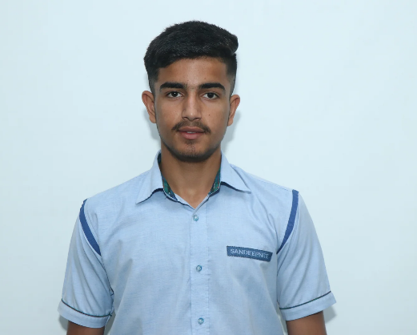
The World at a Glance
By:- Aditya Salaria (XII-Humanities)
Trump Signals “Second Stage” of Sanctions as Russia Strikes Kyiv
Former U.S. President Donald Trump has indicated readiness to escalate sanctions on Russia amid Russian attacks on Kyiv that killed four people, including a three-month-old baby.
French Government Collapses Amid Political Crisis
The Bayrou-led French government lost a no-confidence vote and collapsed on September 8, 2025, triggering political uncertainty.
Norwegian Election: Centre-Left Coalition Holds Lead
Projections from Norway's parliamentary election show the centre-left bloc in the lead with approximately 91 seats, compared to 78 for the right.
Morocco Becomes First African Nation to Qualify for 2026 World Cup
Morocco has secured qualification for the 2026 FIFA World Cup, which will expand to 48 teams. Several other nations, including Argentina, Brazil, Japan, and England, are also progressing or have qualified.
Nasdaq Proposes Tokenized Securities Framework to SEC
Nasdaq has submitted a proposal to the SEC to integrate tokenized securities—like digitized stocks, bonds, and private equities—into traditional markets, signaling a leap toward blockchain-based trading
Punjab Cabinet Approves Major Flood Relief Package
The Punjab government has rolled out a comprehensive relief scheme: ₹20,000 per acre for crop losses, ₹4 lakh ex-gratia for fatalities, and the new “Jisda Khet, Usdi Ret” initiative allowing farmers to extract and sell deposited sand/silt without a mining permit until December 31. It also includes six months of interest-free loan deferments, compensation for damaged homes and livestock, and rapid infrastructure restoration.
The Sandeepni Chronicle | April 2025

Slide 17

Future in the Making: Top Inventions
By:- Manasvi Sambyal (XI-Science)
Quantum Batteries
Revolutionary energy storage devices that use quantum entanglement for ultra-fast charging, impressive longevity (up to 50 years), and eco-friendliness—no toxic materials involved.
Self-Healing Bacteria-Embedded Concrete
Concrete that auto-repairs cracks within 1–2 days using limestone-producing bacteria activated by water—promising reduced infrastructure maintenance and increased sustainability.
Xenobots 2.0—Self-Replicating Living Robots
Tiny biological robots made from frog stem cells capable of movement and self-replication—envisioned for medical delivery systems and environmental cleanups.
Portable Solar-Powered Devices Extracting Water from Air
Lightweight, solar-driven systems that generate clean drinking water from humidity—especially valuable in drought-prone regions like Sub-Saharan Africa and rural India
AI-Powered Classroom Bots
Personalized teaching assistants that adjust lessons using speech recognition and feedback loops—enhancing engagement and support for students in remote or underserved areas.
The Sandeepni Chronicle | April 2025

Slide 18

By Art & Craft Department
The Sandeepni Chronicle | April 2025

Slide 19
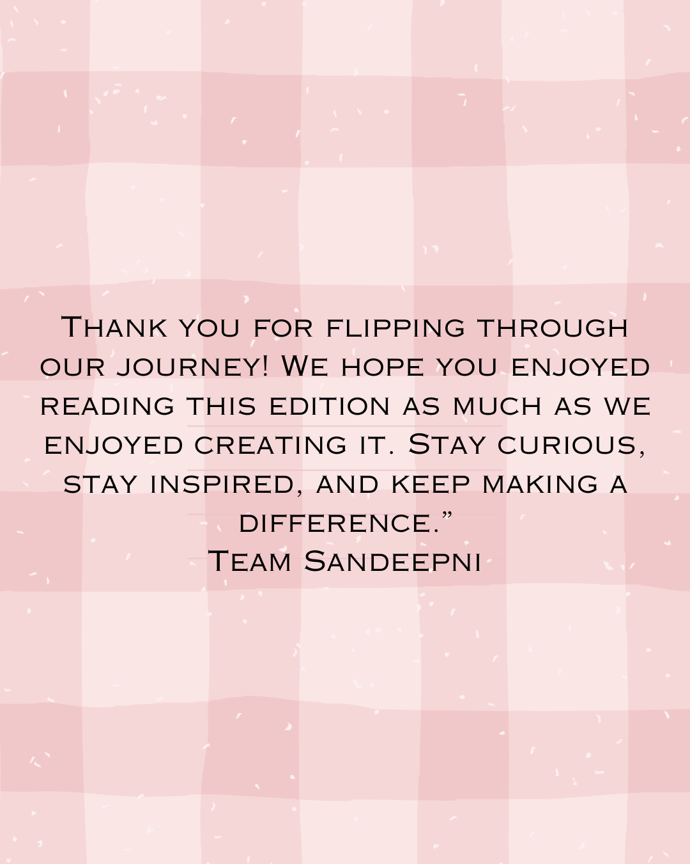
The Sandeepni Chronicle | August 2025

