Slide 1

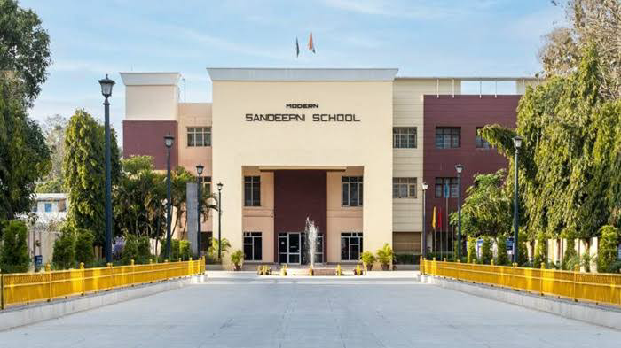
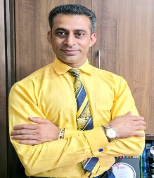
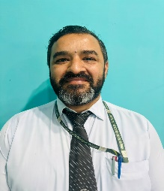
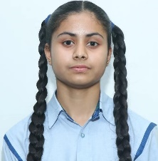

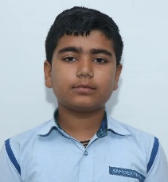
Volume: IV Issue-7
November 2025
The Sandeepni Chronicle
Editorial Team
DR. Neeraj Mohan Puri
Principal
Mr. Sushil
Editor
Student Editors
Manasvi
(XI-Med)
Vaanya
(X-Peace)
Aditya Mehra
(X-Loyal)
The Sandeepni Chronicle | October 2025

Slide 2


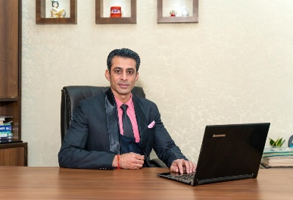
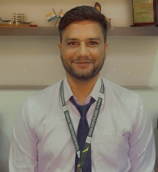
Volume: IV Issue-6
August 2025
The Sandeepni Chronicle
Editorial Team
DR. Neeraj Mohan Puri
Principal
Mr. Sushil
Editor
Mr. Vikram
Art & Design
Student Editors
Manasvi
(XI-Med)
Vaanya
(X-Peace)
Aditya Mehra
(X-Loyal)
The Sandeepni Chronicle | October 2025

Slide 3
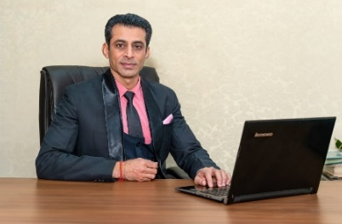
FIRST LOOK
Building Resilience
Life is not always a smooth journey; it is full of twists, turns, and challenges. What truly defines us is not how many times we fall, but how many times we rise again. “The oak fought the wind and was broken, the willow bent when it must and survived.” This beautiful quote reminds us that resilience is the strength to bend without breaking.
Resilience means having the courage to face difficulties, adapt to change, and keep moving forward with hope and positivity. Students today face various pressures—academic stress, peer competition, or personal setbacks—but resilience helps them stay calm and confident even in tough times.
For instance, Thomas Edison failed over a thousand times before inventing the electric bulb. Instead of giving up, he said, “I have not failed. I’ve just found 10,000 ways that won’t work.” His perseverance turned failure into success.
In our school journey, resilience can mean preparing again for an exam we didn’t do well in, learning from mistakes, or handling friendship issues maturely. Remember, every setback is a setup for a stronger comeback.
So, let us develop a positive mindset, seek help when needed, and believe in our ability to overcome challenges. The secret of success lies not in avoiding failures but in bouncing back stronger each time.
“Resilience is not about never falling, but about rising every time we fall.”
Enjoy Reading!
Dr. Neeraj Mohan Puri
The Sandeepni Chronicle | October 2025

Slide 4

The Bookmarks of My Life!!!!
From the Editor’s Desk
We often believe that great success demands extraordinary effort, but the truth is quite the opposite. It is not the giant leaps but the small, consistent steps that shape who we become. The little things we do every day—our habits—determine the kind of life we build.
Think about it: waking up ten minutes early to plan your day, reading just a few pages of a book daily, revising your lessons before sleeping, or simply keeping your room tidy—these may seem insignificant, but over time, they create discipline, focus, and confidence. The power of small habits lies in their consistency. A single drop of water does not fill a pot, but continuous drops eventually do.
Psychologists say that habits shape nearly 40% of our daily actions. That means almost half of what we do is automatic driven by patterns we’ve built over time. If we consciously replace one unhelpful habit with a positive one—like reducing screen time, practicing gratitude, or exercising regularly—we begin a silent revolution within ourselves.
Consider how small changes have transformed great minds. Thomas Edison’s daily curiosity, Dr. A.P.J. Abdul Kalam’s lifelong discipline, or Marie Curie’s persistence—all were built upon steady, everyday habits. Their success wasn’t sudden; it was sculpted one small action at a time.
As students, we often wait for the “right moment” to change—to start studying harder, living healthier, or thinking positively. But the right moment is always now. Begin with something small and stick to it. Over time, these small actions grow into powerful habits that can transform not just your academics but your entire attitude toward life.
So, start small—because the smallest steps, taken with consistency, create the biggest changes.
The Sandeepni Chronicle | October 2025

Slide 5
Parent’s Pen
Small Acts, Big Impact: Building a Culture of Kindness in Our Kids
Small Acts, Big Impact: Building a Culture of Kindness in Our Kids
In today’s busy world, it’s easy to get caught up in routines — school runs, homework, and extracurricular. Yet, amidst all this, one of the most valuable lessons we can teach our children is kindness. It doesn’t require grand gestures; often, the smallest acts make the biggest difference.
Kindness begins at home. When children see parents holding the door open for someone, sharing a smile, or offering help without being asked, they learn that compassion is a way of life. These moments become their model for how to treat others. Simple family practices, like writing thank-you notes, helping a neighbour, or donating outgrown clothes, remind children that every act of giving matters.
Schools play a vital role, too. When kindness is celebrated — through peer appreciation boards, teamwork activities, or community projects — children learn that empathy is valued just as much as academic success.
Encouraging kids to notice the good around them helps them understand that kindness is contagious. A kind word to a classmate, including someone in a game, or simply listening to a friend who needs support can brighten someone’s day.
As parents and educators, our shared goal is to raise not just smart students, but caring individuals. When kindness becomes part of our daily routine, we create a ripple effect — one small act at a time — that shapes a more compassionate world for everyone.
Proud Parents of
The Sandeepni Chronicle | October 2025

Slide 6
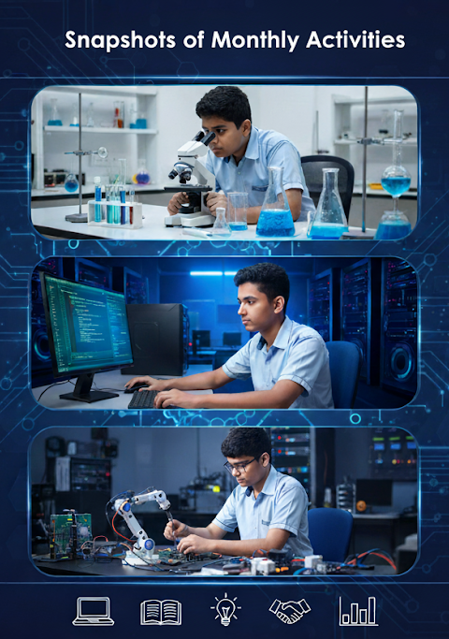

Slide 7
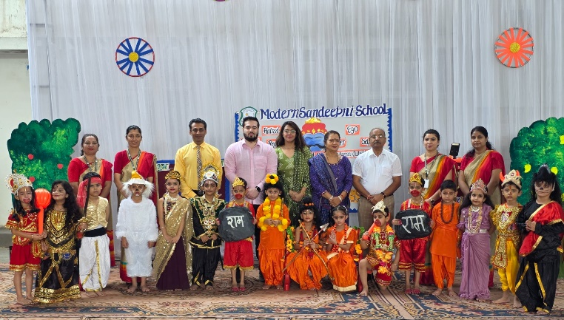
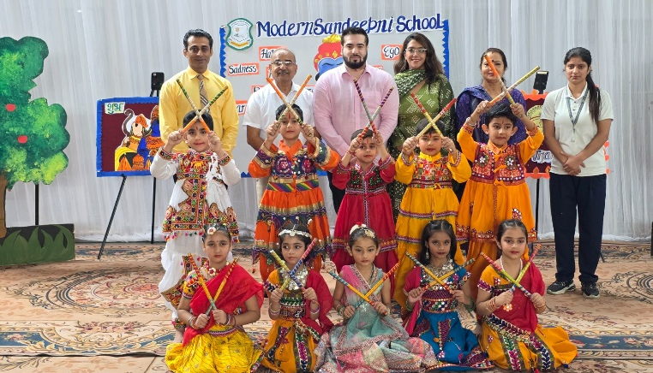
Celebrating the Triumph of Good Over Evil: Dussehra 2025
Article By:- Ms. Navneet Kaur
The spirit of festivity and cultural pride filled the air as our school celebrated Dussehra with great enthusiasm on October 1st. The occasion was graced by our esteemed Principal Dr. Neeraj Mohan Puri, Chairman Captain Salil Mahajan, Director Er. Pawan Mahajan, and Manageress Mrs. Pinky Mahajan.
The event began with the ceremonial lighting of the lamp, setting a divine tone for the day. Students beautifully sang the 'Luv-Kush Gatha', paying homage to the legacy of Lord Ram through soulful music. This was followed by an impressive dramatization that showcased the journey of Shri Ram Chandra Ji, from his exile to the defeat of Ravana, reflecting the values of courage, truth, and devotion.
In his address, Dr. Neeraj Mohan Puri shared valuable words of wisdom, urging students to walk on the path of righteousness and emulate the virtues of Lord Rama in their lives. Director Er. Pawan Mahajan explained the true significance of Dussehra, emphasizing how the festival reminds us that good always triumphs over evil, no matter how strong the darkness may appear.
Chairman Captain Salil Mahajan and Manageress Mrs. Pinky Mahajan praised the dedication of students and staff for putting together such a meaningful and culturally rich celebration.
The event concluded with the symbolic burning of Ravana’s effigy, inspiring everyone to conquer their inner evils. It was truly a day of learning, celebration, and reflection.
The Sandeepni Chronicle | October 2025

Slide 8
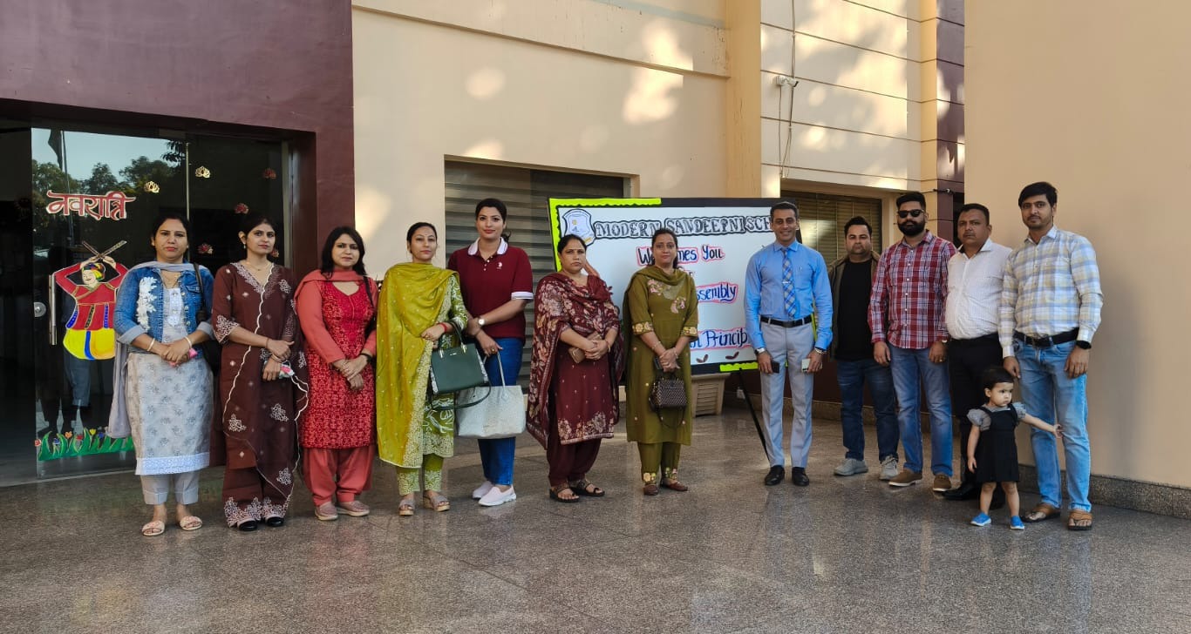
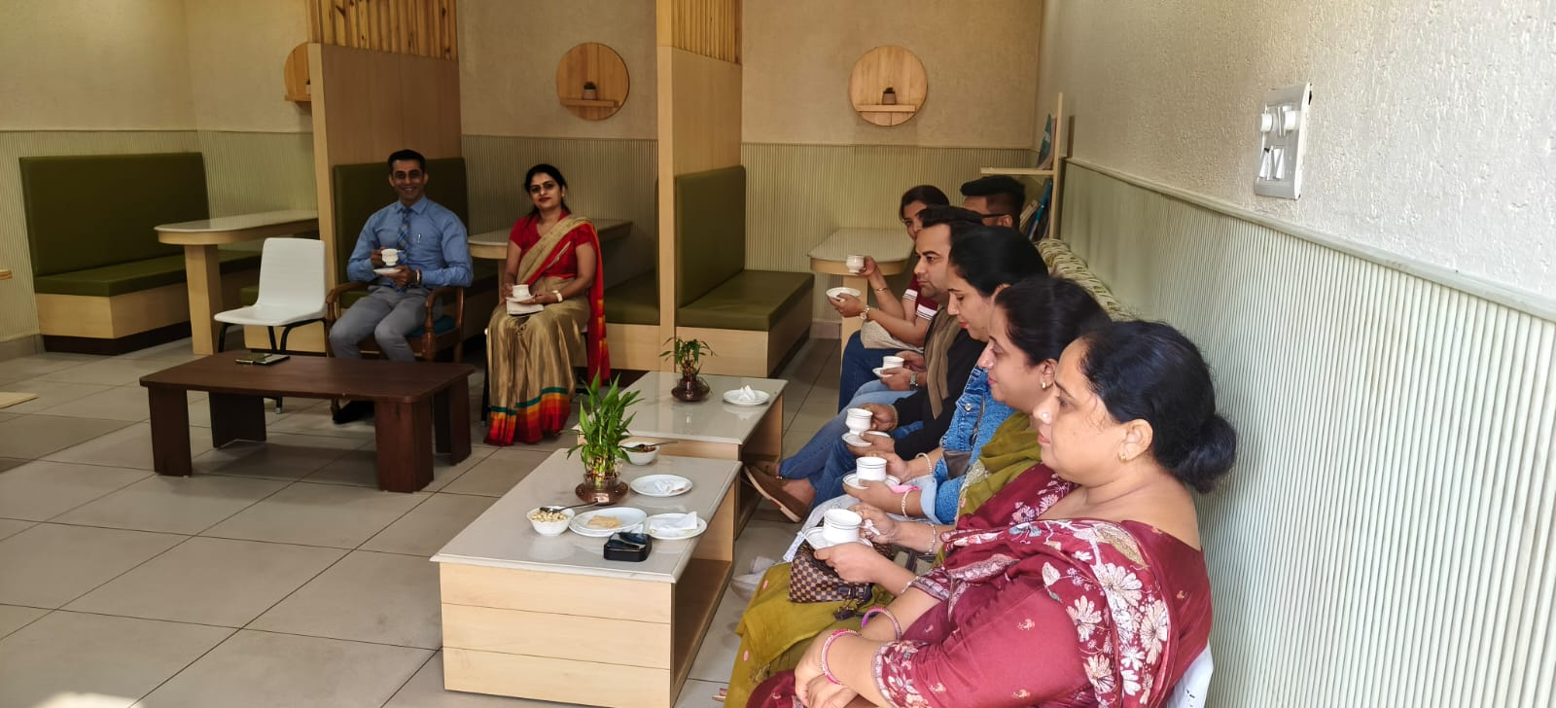
Coffee with the Principal: Honoring the Body, Inspiring the Mind
Article by:- Ms. Ambika Pathania
Modern Sandeepni School recently organized a heartwarming and insightful interactive session titled “Coffee with the Principal” centered around the meaningful theme “Body is Temple.” The event beautifully embodied the school’s philosophy of holistic education and its dedication to fostering strong parent–school collaboration.
The session commenced with an inspiring thought, followed by a powerful motivational speech and a soulful Sanskrit shloka, highlighting the deep-rooted value of treating our bodies as sacred temples. This set a reflective tone for the rest of the event.
Students added charm to the morning with a vibrant performance that showcased their creativity, self-expression, and deep understanding of the theme. Their energy and confidence were truly commendable. A special segment featuring fascinating physics facts illustrated the connection between science and everyday well-being, adding an intellectual dimension to the event.
The most engaging part of the session was an interactive Q&A where students posed thoughtful questions to parents. This segment brought smiles, sparked meaningful dialogue, and deepened mutual respect, making it a highlight of the program. Parents responded enthusiastically, creating a lively and warm atmosphere.
The “Coffee with the Principal” session truly reflected the spirit of Modern Sandeepni School—where education is not confined to textbooks, but extends to values, communication, and conscious living. It was a celebration of learning, collaboration, and the school’s commitment to nurturing mindful, confident, and responsible individuals.
The Sandeepni Chronicle | October 2025

Slide 9
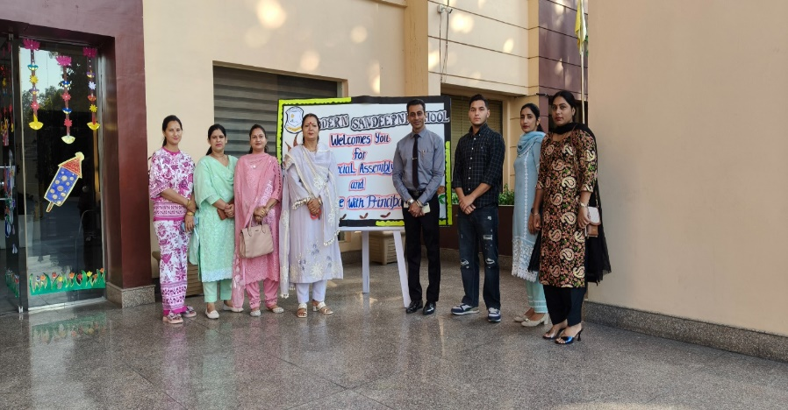
Brewing Inspiration: Coffee With Principal
Article by:- Ms. Sonia
The CWP (Coffee With Principal) session for the parents of Grade IX students was conducted with great enthusiasm and warmth on October 17,2025.
The event began with the welcome of parents, Manageress-Mrs. Pinky Mahajan, and Principal- Dr. Neeraj Mohan Puri. The assembly revolved around the inspiring theme “Learning from Failures”, beautifully presented through a radio show that included a poem recitation, an engaging skit, and an interview with a state level swimming sportsperson from Grade IX.
The performances not only showcased students’ creativity but also conveyed the valuable message that every setback is a step towards success. Adding a personal touch to the event, students expressed their feelings for their parents by presenting handmade cards, creating a heartwarming moment. The parents, in turn, appreciated the wonderful performances and shared their positive feedback about the school, staff, and the thoughtful organization of the CWP session.
The event concluded with a delightful Coffee with Principal interaction, where parents and the school leadership got engaged in meaningful dialogue about students’ growth and school initiatives. The session proved to be a perfect blend of creativity, connection, and communication — truly reflecting the essence of Coffee With Principal.
The Sandeepni Chronicle | October 2025

Slide 10
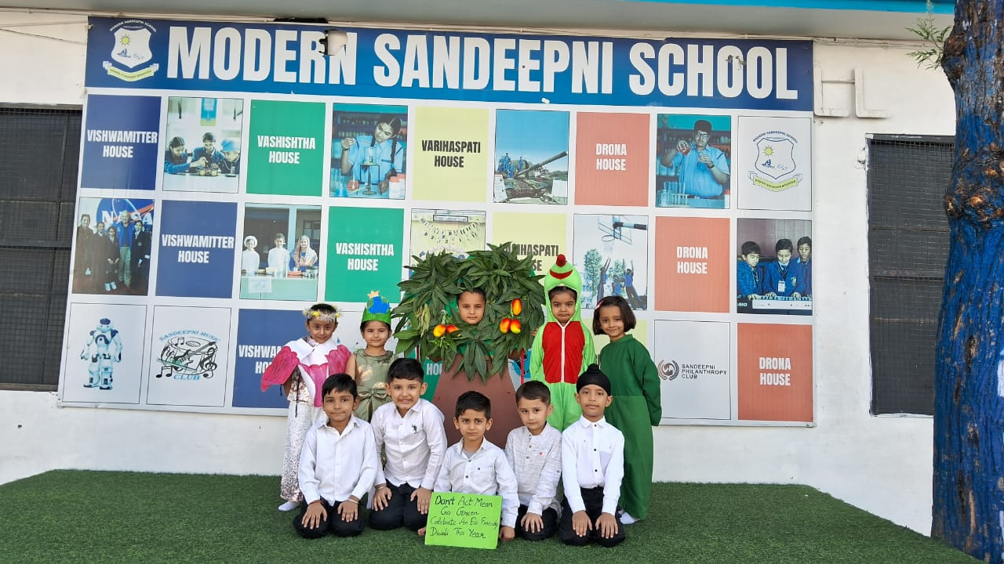
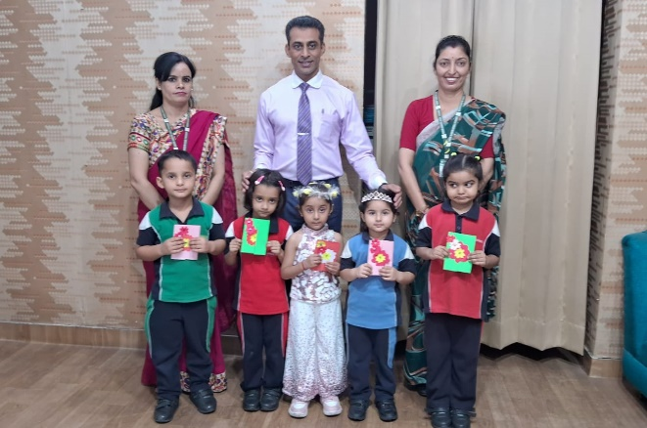
Little Stars Shine for a Green Diwali
Article by:- Ms. Shanali
The LKG students of our school presented a delightful play on Green Diwali, spreading an inspiring message about celebrating the festival in an eco-friendly way. The young learners beautifully portrayed the importance of protecting our environment and demonstrated that true joy lies in celebrating with diyas, sweets, and smiles instead of crackers and smoke. Their enthusiasm and innocence filled the atmosphere with happiness and hope.
The play emphasized that a clean and green Diwali is indeed a happy Diwali. The vibrant costumes, expressive dialogues, and cheerful performances made the event memorable for everyone present. The message of reducing pollution and caring for nature was conveyed in the most heartwarming manner by our tiny tots.
Our respected Principal, Dr. Neeraj Mohan Puri, graced the occasion and shared his words of wisdom with the students. He appreciated their wonderful performance and encouraged everyone to follow the message of celebrating a pollution-free and safe Diwali. Dr. Puri praised the efforts of the teachers and parents for guiding the children and instilling in them values of environmental responsibility.
The event concluded with loud applause and smiles all around, marking a meaningful start to the festive season.
The Sandeepni Chronicle | October 2025

Slide 11
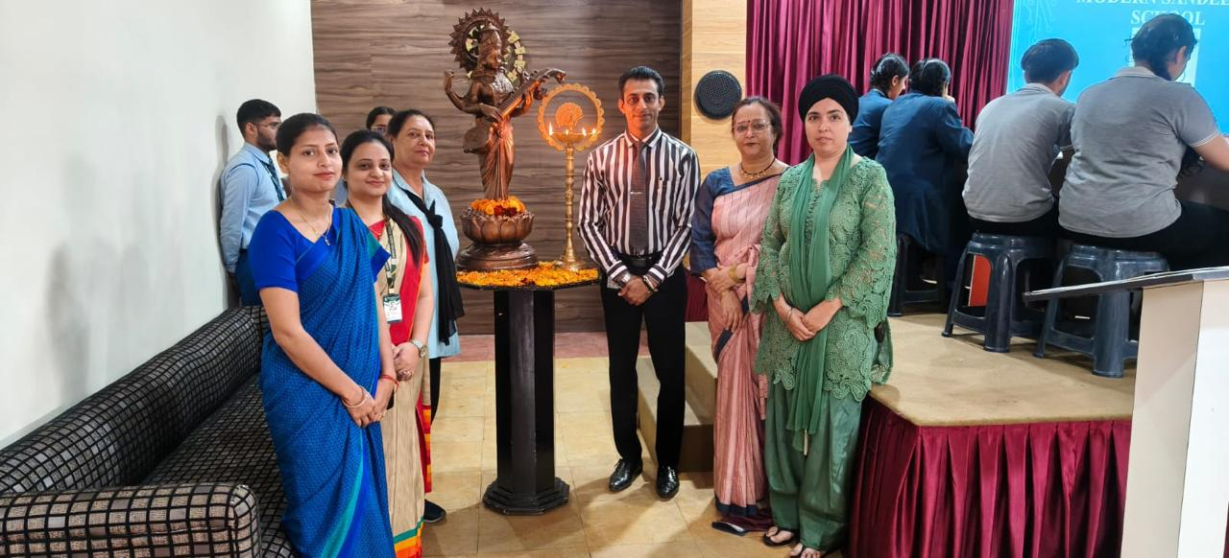
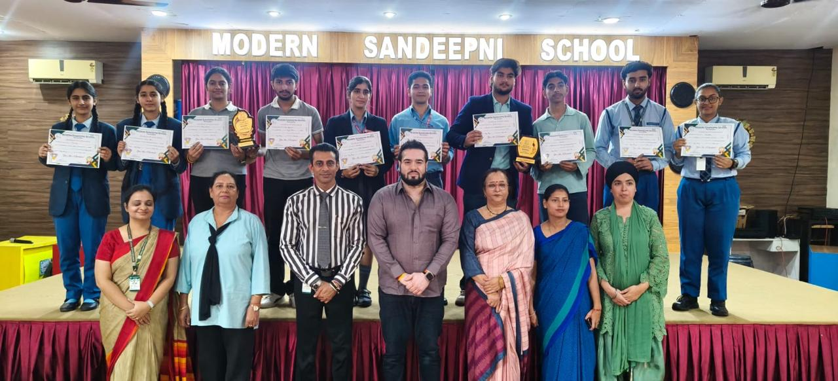
Inter School BizQuiz
Article by:- Ms. Aradhna
An Inter School BizQuiz-01 was organized on October 31st at MODERN SANDEEPNI SCHOOL, bringing together the brightest young business minds from five participating schools. The event aimed to promote awareness of current business trends, corporate affairs, and entrepreneurial thinking among students.
A total of five schools took part in the competition, with each team comprising two members. The quiz consisted of multiple rounds, including Business Awareness, Logo Identification, Rapid Fire, and a Final Buzzer Round. Each round tested the participants’ knowledge, speed, and analytical skills.
The event commenced with a welcome address by Ms.Aradhna, followed by the lighting of the lamp ceremony. The highlight of the program was the enthusiastic participation and healthy competition among the teams, which kept the audience thoroughly engaged.
After an intense and exciting contest, Angels Public School emerged as the winner of the Inter School BizQuiz 2025, showcasing exceptional business acumen and teamwork.
The event concluded with a motivational address by our respected Chairman Captain Salil Mahajan and Notable Principal Dr. Neeraj Mohan Puri, who congratulated all participants for their commendable performance and encouraged them to continue enhancing their knowledge beyond textbooks. Certificates and trophies were awarded to the winners and participants.
The Inter School BizQuiz was a grand success, fostering a spirit of learning, collaboration, and competitiveness among students, while also strengthening inter-school relationships.
The Sandeepni Chronicle | October 2025

Slide 12
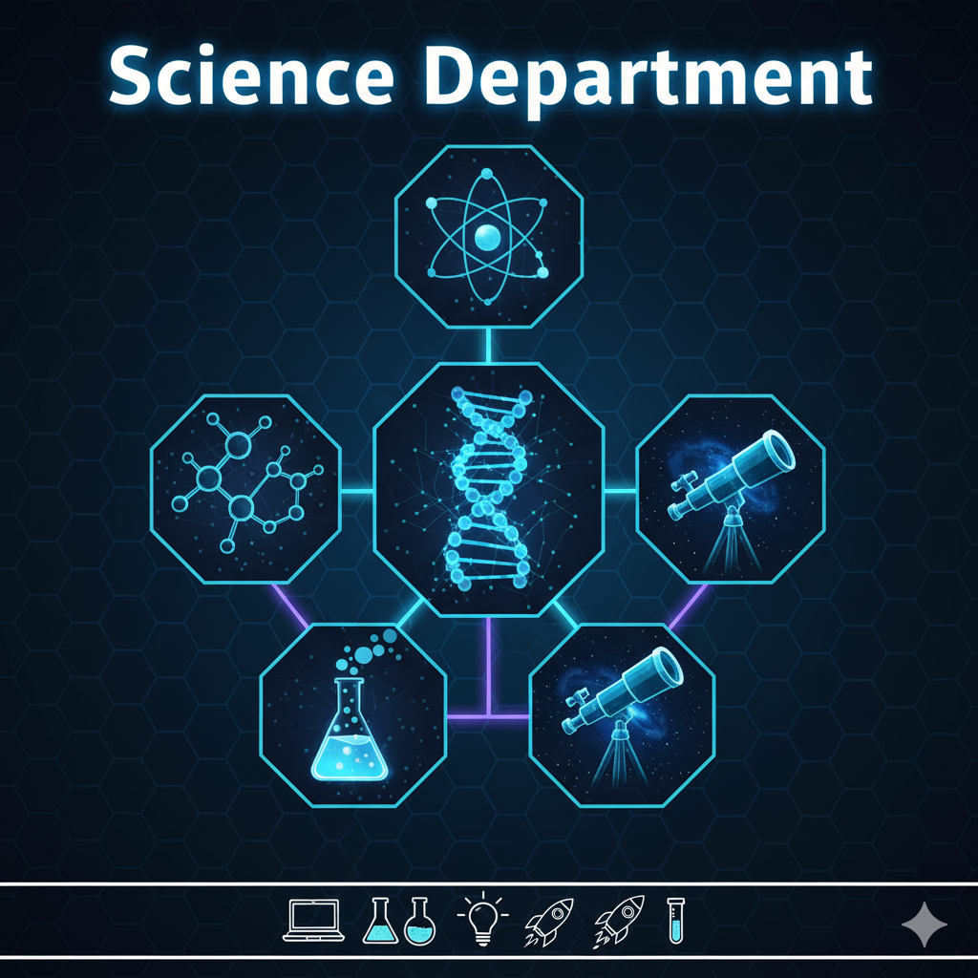

Slide 13
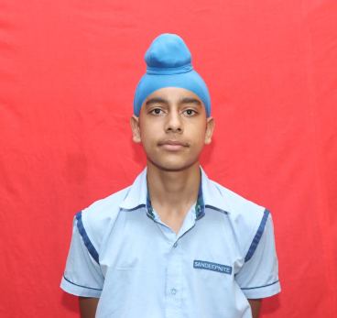
Advances in Medical Biotechnology
New Vaccines, Gene Editing, and Lab-Grown Organs
Article by:- Charanjot Singh ( IX Peace)
Biotechnology has become one of the most exciting and rapidly advancing fields in modern science. Its influence on medicine is transforming how we prevent, diagnose, and treat diseases, offering new hope for patients around the world.
1. New Vaccines for a Safer Future
Recent years have seen the development of next-generation vaccines using biotechnology. mRNA vaccines, such as those created for COVID-19, represent a major breakthrough. They can be designed and produced quickly, helping the world respond faster to new viruses. Scientists are now working on similar vaccines for flu, malaria, and even certain types of cancer.
2. Gene Editing: Correcting DNA Errors
Gene editing technologies like CRISPR-Cas9 allow scientists to precisely modify genes inside living cells. This innovation holds the potential to cure genetic disorders such as sickle cell anemia and muscular dystrophy. It also enables researchers to study diseases more accurately and develop targeted treatments.
3. Lab-Grown Organs: A Solution to Transplant Shortages
Tissue engineering and 3D bioprinting are making it possible to grow human organs in the laboratory. Scientists have successfully grown mini-hearts, livers, and kidneys from stem cells. In the future, lab-grown organs could replace damaged ones, reducing transplant waiting times and saving countless lives.
Conclusion
Medical biotechnology continues to push boundaries, offering life-changing innovations. From new vaccines to genetic therapies and lab-grown organs, these advancements are paving the way for a healthier, more sustainable future.
The Sandeepni Chronicle | October 2025

Slide 14


Slide 15

Digital Payments and the Cashless Economy
Article by:- Charvi ( XII-Com)
In today’s fast-changing world, digital payments have become a key part of our daily lives. From buying groceries to paying bills, technology has made money transactions quicker, safer, and more convenient. The move toward a cashless economy is transforming how individuals and businesses handle money.
The Rise of Digital Transactions
With the growth of smartphones and the internet, people now prefer using mobile wallets, UPI (Unified Payments Interface), and online banking instead of carrying cash. Apps like Google Pay, PhonePe, and Paytm allow instant money transfers anytime and anywhere. These methods are not only user-friendly but also reduce the risks of theft and counterfeit currency.
Benefits for Businesses and Consumers
Digital payments make record-keeping easier for businesses and promote transparency in financial transactions. For consumers, they offer rewards, cashback, and the convenience of contactless shopping. Governments also benefit from better tax collection and reduced cash-handling costs.
Challenges and the Way Forward
While digital payments are growing rapidly, issues like cyber security, internet access, and digital literacy remain important challenges. Ensuring safe and inclusive digital systems will help more people join the cashless revolution.
Conclusion
The shift toward digital payments marks a major step toward a modern, connected economy. As technology continues to advance, a cashless future is not just possible — it’s already becoming a reality.
The Sandeepni Chronicle | October 2025

Slide 16


Slide 17
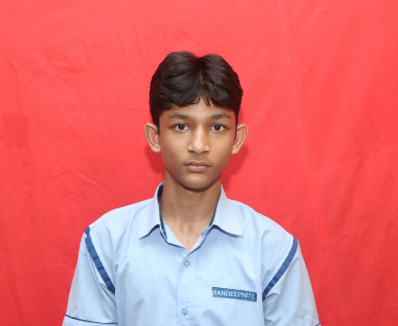
Artificial Intelligence in Everyday Life
Article by:- Karmanya ( IX Peace)
Artificial Intelligence (AI) is no longer a futuristic concept — it has quietly become part of our daily routines. From the moment we unlock our phones with facial recognition to the time we stream our favorite shows, AI is working behind the scenes to make life easier and more efficient.
Smart Assistance and Communication
Virtual assistants like Siri, Alexa, and Google Assistant use AI to understand voice commands, answer questions, and control smart devices. Chatbots also help businesses handle customer queries instantly, making communication faster and more convenient.
Personalized Experiences
AI studies our preferences and behaviors to provide personalized recommendations. Platforms like Netflix, YouTube, and Spotify suggest shows or songs based on what we like. Even online shopping sites use AI to recommend products tailored to our interests.
AI in Daily Services
AI is transforming essential services too. In healthcare, it helps doctors analyze scans and detect diseases early. In finance, AI detects fraud and assists with secure online transactions. Navigation apps like Google Maps use AI to find the fastest routes and predict traffic patterns.
Conclusion
Artificial Intelligence is shaping a smarter, more connected world. It saves time, improves accuracy, and enhances convenience in ways we often overlook. As AI continues to evolve, it will keep finding new ways to simplify and enrich our everyday lives.
The Sandeepni Chronicle | October 2025

Slide 18


Slide 19
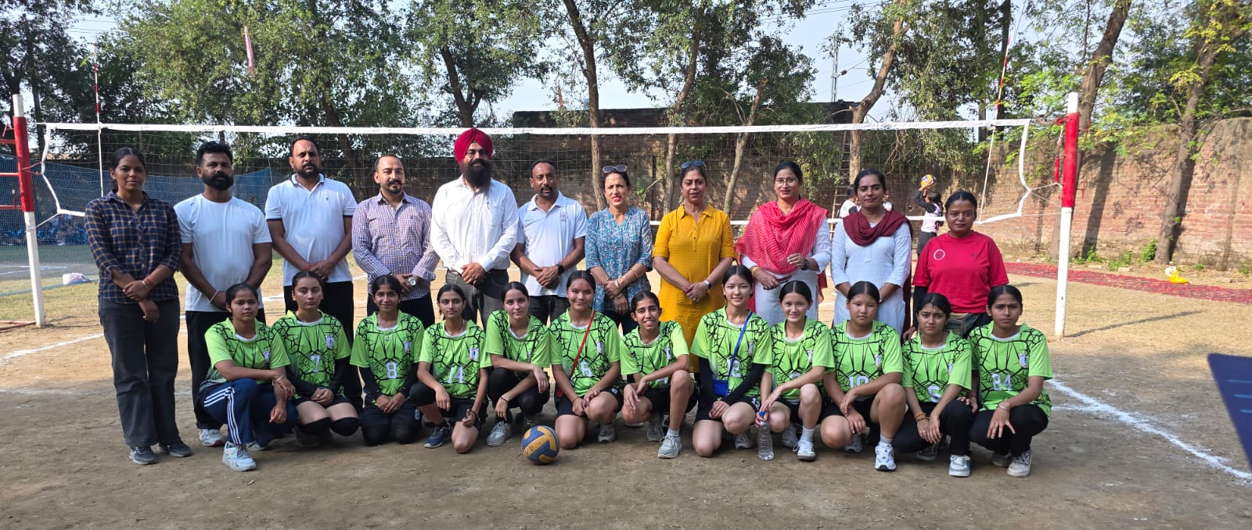
Sandeepnites Shine at the 69th Punjab School Games
Report by:- Mr. Surjit
The 69th Punjab School Games (State Level Tournament) for Girls Under-19 was held at Tarn Taran with great enthusiasm and sportsmanship. The event brought together talented young athletes from across the state, showcasing their skills, determination, and passion for sports.
It is a matter of great pride that students from our school—Dhriti Puri, Ridhima Sharma, Tsetan Lamo, Dechean Lamo, and Tsering—proudly represented us in this prestigious tournament. Their participation not only reflected their hard work and dedication but also the school’s commitment to promoting sports and overall development among students.
Throughout the tournament, our players displayed excellent teamwork, discipline, and sportsmanship. Competing against some of the best players in the state, they performed with confidence and determination, making their mark in their respective events. Their spirited participation was appreciated by coaches and spectators alike.
Such events provide a valuable platform for young players to enhance their sporting abilities and gain exposure to higher levels of competition. The experience our students gained from this tournament will certainly motivate them to strive harder and achieve even greater success in the future.
The school congratulates Dhriti Puri, Ridhima Sharma, Tsetan Lamo, Dechean Lamo, and Tsering for their commendable performance and for bringing honor to the institution. Their participation in the State Level Tournament is indeed a moment of pride for all Sandeepnites.
The Sandeepni Chronicle | October 2025

Slide 20
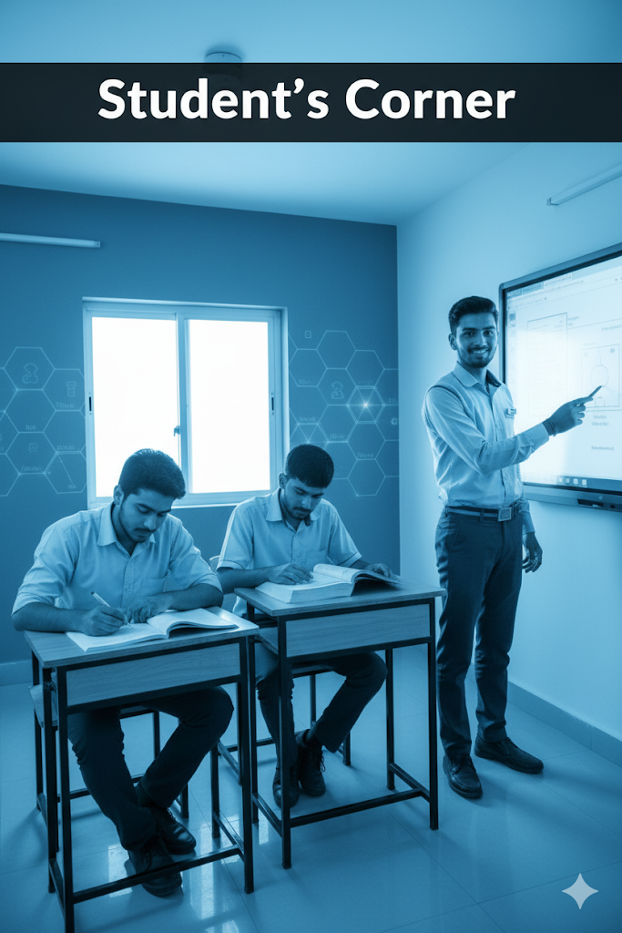

Slide 21

Book Review
Atomic Habits by James Clear
Reviewed by:-Shreevali (XI-Science)
Atomic Habits by James Clear is an insightful guide to personal growth and behavior change. Clear presents a simple yet powerful framework for building good habits and breaking bad ones through small, consistent actions. The book emphasizes that lasting transformation doesn’t come from huge leaps but from tiny improvements made daily—what Clear calls “atomic habits.” With engaging stories, scientific research, and practical advice, he explains the four laws of behavior change: make it obvious, attractive, easy, and satisfying. Clear’s writing is clear, motivating, and grounded in real-world applications, making complex psychology easy to understand. What sets this book apart is its focus on systems rather than goals—helping readers focus on the process, not just outcomes. Atomic Habits is an essential read for anyone seeking meaningful self-improvement, offering actionable strategies to create lasting positive change in both personal and professional life.
The Sandeepni Chronicle | October 2025

Slide 22
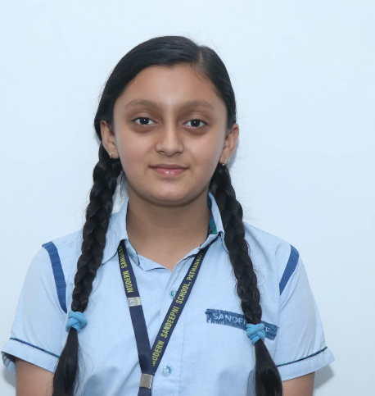
Digital Learning: A New Era in Education
By:- Deevisha (VIII Loyal)
Education in the 21st century has entered a new digital era that is transforming how students learn and teachers teach. Technology has turned classrooms into interactive spaces filled with creativity and innovation. Through digital tools such as online classes, smart boards, and educational apps, students are now able to learn beyond textbooks and explore the world with just a click.
Digital learning makes education accessible to all. It allows students to study at their own pace, revisit lessons anytime, and use multimedia to better understand concepts. This flexibility helps children become independent learners and boosts their confidence. Teachers, too, are adapting by using technology to make lessons more engaging and student-centered.
However, the role of discipline and balance remains crucial. Students must use technology wisely—learning when to switch off devices and focus on real-life interactions. Schools now emphasize digital responsibility so that students grow into mindful global citizens.
At our school, digital learning is not just about screens; it’s about empowering students to think critically, create boldly, and communicate effectively. As we move forward, technology will continue to redefine education, making learning not only smarter but also more meaningful.
Digital education is the bridge between knowledge and imagination.
The Sandeepni Chronicle | October 2025

Slide 23

शिक्षा का वास्तविक अर्थ
By:- Deeher ( IX Loyal)
शिक्षा मानव जीवन का सबसे मूल्यवान खजाना है। यह केवल ज्ञान अर्जित करने का माध्यम नहीं, बल्कि जीवन जीने की कला सिखाने का साधन है। शिक्षा का वास्तविक अर्थ केवल पढ़ना-लिखना नहीं, बल्कि सही सोच, सही व्यवहार और सही निर्णय लेने की क्षमता विकसित करना है। एक सच्चा शिक्षित व्यक्ति वही है जो अपने ज्ञान का उपयोग समाज और मानवता की भलाई के लिए करे।
आज के समय में जब तकनीक और प्रतियोगिता जीवन का हिस्सा बन गई हैं, शिक्षा का स्वरूप भी बदल रहा है। लेकिन हमें यह नहीं भूलना चाहिए कि शिक्षा का मूल उद्देश्य केवल रोजगार प्राप्त करना नहीं है, बल्कि एक अच्छा नागरिक और संवेदनशील इंसान बनना है। शिक्षा हमें सिखाती है कि कैसे दूसरों का सम्मान करें, समाज में सहयोग की भावना रखें और नैतिक मूल्यों को अपने जीवन में अपनाएँ।
विद्यालय में शिक्षक विद्यार्थियों को न केवल विषयों का ज्ञान देते हैं, बल्कि अनुशासन, ईमानदारी, परिश्रम और सहानुभूति जैसे जीवन मूल्यों की शिक्षा भी प्रदान करते हैं। शिक्षा व्यक्ति के मन, मस्तिष्क और आत्मा तीनों का विकास करती है। जब कोई व्यक्ति शिक्षित होता है, तो वह न केवल अपने लिए, बल्कि समाज के लिए भी एक सकारात्मक परिवर्तन का माध्यम बनता है।
अंततः, सच्ची शिक्षा वही है जो व्यक्ति के अंदर मानवता, करुणा और सच्चाई के गुणों को जागृत करे। शिक्षा हमें केवल सफल नहीं, बल्कि सच्चा और अच्छा इंसान बनाती है।
यही शिक्षा का वास्तविक अर्थ है — ज्ञान से अधिक, चरित्र निर्माण और मानवीयता का विकास।
The Sandeepni Chronicle | October 2025

Slide 24
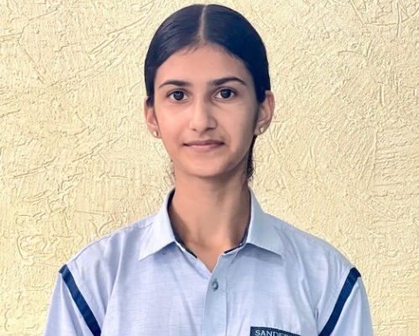
ਸਿੱਖਿਆ ਤੇ ਅਨੁਸ਼ਾਸਨ
By:- Varnika Kaur (X-Loyal)
ਸਿੱਖਿਆ ਮਨੁੱਖੀ ਜੀਵਨ ਦੀ ਸਭ ਤੋਂ ਵੱਡੀ ਤਾਕਤ ਹੈ। ਇਹ ਸਾਨੂੰ ਸਿਰਫ਼ ਗਿਆਨ ਹੀ ਨਹੀਂ ਦਿੰਦੀ, ਸਗੋਂ ਜੀਵਨ ਨੂੰ ਸੁਧਾਰਨ ਦਾ ਰਸਤਾ ਵੀ ਦਿਖਾਂਦੀ ਹੈ। ਪਰ ਸਿੱਖਿਆ ਤਦ ਹੀ ਪੂਰੀ ਹੁੰਦੀ ਹੈ ਜਦੋਂ ਇਸ ਨਾਲ ਅਨੁਸ਼ਾਸਨ ਜੁੜਿਆ ਹੋਵੇ। ਅਨੁਸ਼ਾਸਨ ਸਾਨੂੰ ਆਪਣੇ ਜੀਵਨ ਵਿੱਚ ਕਾਇਦੇ-ਨਿਯਮਾਂ ਦੀ ਪਾਲਣਾ ਕਰਨਾ ਸਿਖਾਂਦਾ ਹੈ। ਇਹ ਸਾਨੂੰ ਸਫਲਤਾ ਦੀ ਓਰ ਲੈ ਜਾਣ ਵਾਲਾ ਮੂਲ ਮੰਤ੍ਰ ਹੈ।
ਸਕੂਲ ਵਿੱਚ ਅਧਿਆਪਕ ਵਿਦਿਆਰਥੀਆਂ ਨੂੰ ਸਿਰਫ ਵਿਸ਼ਿਆਂ ਦੀ ਸਿੱਖਿਆ ਨਹੀਂ ਦਿੰਦੇ, ਸਗੋਂ ਉਨ੍ਹਾਂ ਨੂੰ ਅਨੁਸ਼ਾਸਿਤ ਜੀਵਨ ਜੀਊਣ ਦੀ ਪ੍ਰੇਰਣਾ ਵੀ ਦਿੰਦੇ ਹਨ। ਜਦੋਂ ਵਿਦਿਆਰਥੀ ਅਨੁਸ਼ਾਸਨ ਨਾਲ ਰਹਿੰਦਾ ਹੈ, ਉਹ ਆਪਣਾ ਸਮਾਂ ਠੀਕ ਤਰੀਕੇ ਨਾਲ ਵਰਤਦਾ ਹੈ ਅਤੇ ਆਪਣੀ ਪੜ੍ਹਾਈ 'ਤੇ ਪੂਰਾ ਧਿਆਨ ਦੇ ਸਕਦਾ ਹੈ। ਅਨੁਸ਼ਾਸਨ ਸਾਨੂੰ ਮਿਹਨਤੀ, ਜ਼ਿੰਮੇਵਾਰ ਅਤੇ ਆਦਰਯੋਗ ਬਣਾਉਂਦਾ ਹੈ।
ਇੱਕ ਅਨੁਸ਼ਾਸਿਤ ਵਿਦਿਆਰਥੀ ਹਮੇਸ਼ਾ ਆਪਣੇ ਲਕਸ਼ ਨੂੰ ਪ੍ਰਾਪਤ ਕਰ ਲੈਂਦਾ ਹੈ ਕਿਉਂਕਿ ਉਹ ਜਾਣਦਾ ਹੈ ਕਿ ਮਿਹਨਤ ਅਤੇ ਸਮੇਂ ਦੀ ਪਾਬੰਦੀ ਸਫਲਤਾ ਦੀਆਂ ਕੁੰਜੀਆਂ ਹਨ। ਅਨੁਸ਼ਾਸਨ ਸਾਨੂੰ ਸਹਿਯੋਗ, ਸੱਚਾਈ ਅਤੇ ਧੀਰਜ ਵਰਗੀਆਂ ਗੁਣਾਂ ਨੂੰ ਜੀਵਨ ਵਿੱਚ ਲੈ ਕੇ ਆਉਣ ਲਈ ਪ੍ਰੇਰਿਤ ਕਰਦਾ ਹੈ।
ਅੱਜ ਦੇ ਸਮੇਂ ਵਿੱਚ ਜਦੋਂ ਤਕਨੀਕ ਅਤੇ ਮੋਬਾਈਲ ਨੇ ਬੱਚਿਆਂ ਦਾ ਧਿਆਨ ਕਈ ਪਾਸਿਆਂ ਵੰਡ ਦਿੱਤਾ ਹੈ, ਅਨੁਸ਼ਾਸਨ ਦੀ ਲੋੜ ਹੋਰ ਵੀ ਵਧ ਗਈ ਹੈ। ਸਿੱਖਿਆ ਦਾ ਮਕਸਦ ਸਿਰਫ਼ ਅੰਕ ਲੈਣਾ ਨਹੀਂ, ਸਗੋਂ ਜੀਵਨ ਦੇ ਸਹੀ ਮੁੱਲਾਂ ਨੂੰ ਸਮਝਣਾ ਵੀ ਹੈ।
ਇਸ ਲਈ ਹਰ ਵਿਦਿਆਰਥੀ ਨੂੰ ਚਾਹੀਦਾ ਹੈ ਕਿ ਉਹ ਸਿੱਖਿਆ ਨਾਲ ਨਾਲ ਅਨੁਸ਼ਾਸਨ ਨੂੰ ਵੀ ਆਪਣੇ ਜੀਵਨ ਦਾ ਅਟੁੱਟ ਹਿੱਸਾ ਬਣਾਏ।
ਅਸਲ ਸਿੱਖਿਆ ਉਹੀ ਹੈ ਜੋ ਸਾਨੂੰ ਗਿਆਨਵਾਨ, ਅਨੁਸ਼ਾਸਿਤ ਅਤੇ ਚੰਗਾ ਇਨਸਾਨ ਬਣਾਏ।
The Sandeepni Chronicle | October 2025

Slide 25
📰 Chronicle Chuckles
“Because laughter is the best homework!” 😄
1️⃣ Teacher: Why are you late?
Student: Because the bell rang before I reached!
2️⃣Why did the student bring a ladder to school?
→ To go to high school! 🎓
3️⃣ Why did the scarecrow win an award?
→ Because he was outstanding in his field! 🌾
4️⃣ What’s a teacher’s favorite nation?
→ Expla-nation!
5️⃣ Why did the student eat his homework?
→ Because the teacher said it was a piece of cake! 🎂
6️⃣ What do you call a sleeping bull?
→ A bulldozer! 🐂💤
7️⃣ Why was the math book sad?
→ It had too many problems.
8️⃣ What did one wall say to the other wall?
→ “Meet you at the corner!”
The Sandeepni Chronicle | October 2025

Slide 26
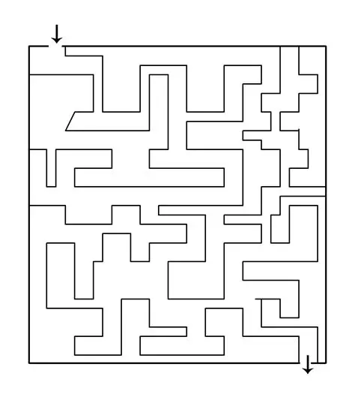
Maze: From Start to Finish
The Sandeepni Chronicle | October 2025

Slide 27

By Art & Craft Department
The Sandeepni Chronicle | October 2025

Slide 28
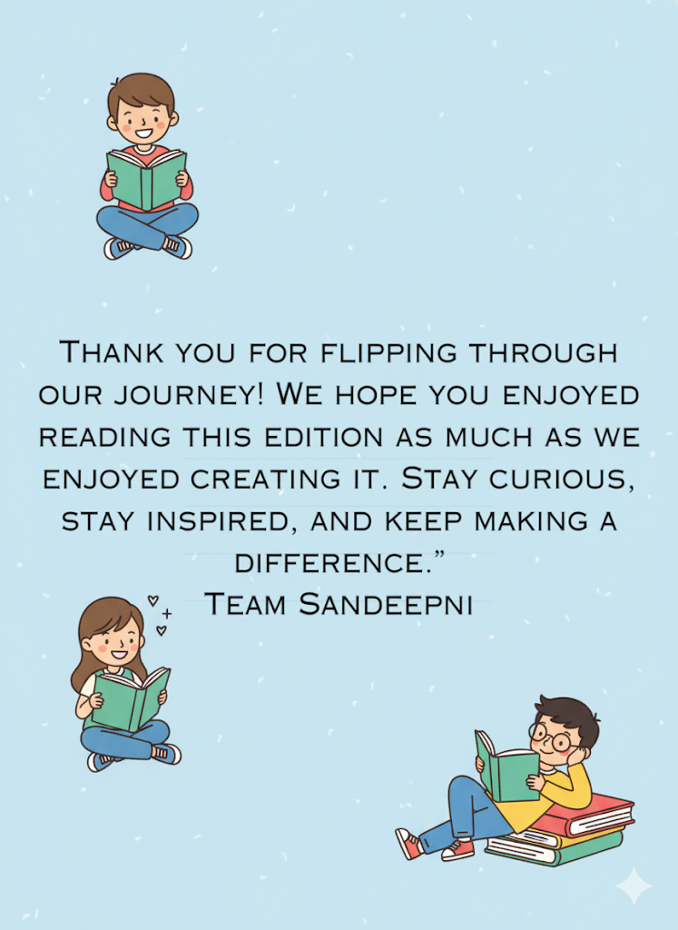
The Sandeepni Chronicle | October 2025

