Slide 1
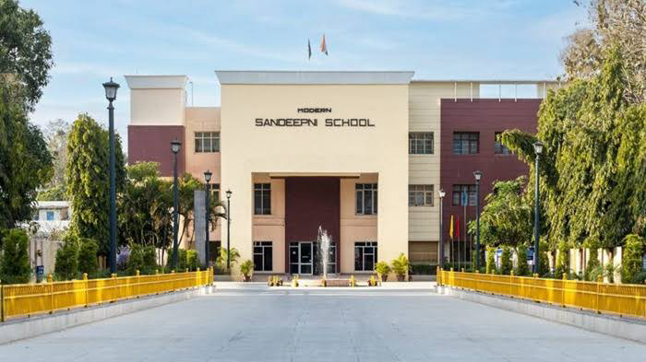
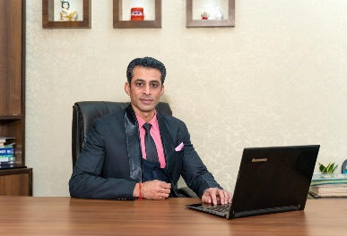
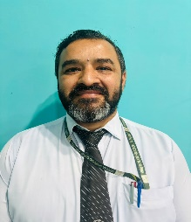
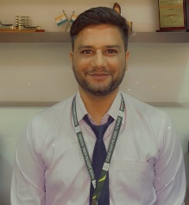
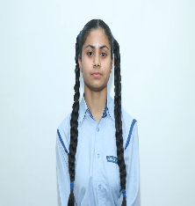
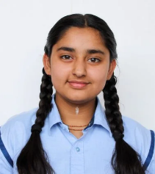
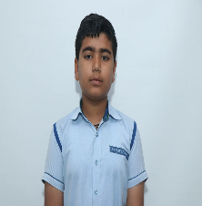
Volume: IV Issue-2
May 2025
The Sandeepni Chronicle
Editorial Team
DR. Neeraj Mohan Puri
Principal
Mr. Sushil
Editor
Mr. Vikram
Art & Design
Student Editors
Manasvi
(XI-Med)
Vaanya
(X-Peace)
Aditya Mehra
(X-Loyal)
The Sandeepni Chronicle | April 2025

Slide 2
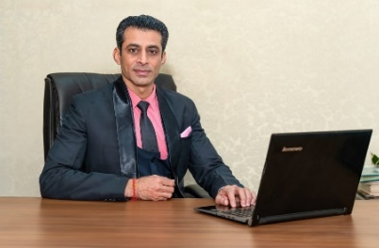
FIRST LOOK
Innovation and Creativity in Students' Life
In the vibrant world of a student, where every day unfolds like a fresh page, innovation and creativity are the magical inks that bring those pages to life! These aren't just fancy buzzwords tossed around in tech seminars—they're the superpowers of modern student life!
Creativity isn't limited to art or music; it's the ability to think differently, to see patterns where others see chaos, and to dream beyond the obvious. Whether you're designing a science project, writing an essay, or even organizing a school event—creativity sparks originality. Innovation then takes that spark and builds a fire, transforming ideas into actions!
“Imagination is more important than knowledge. For knowledge is limited, whereas imagination embraces the entire world.”
— Albert Einstein ✨
When students embrace creativity, they become problem-solvers, thinkers, and future leaders. Innovation makes school more than just marks—it becomes a playground of endless possibilities. From coding apps in computer class to crafting eco-friendly models in science fairs, these are the seeds of tomorrow’s genius.
“Don’t be afraid to be creative. It’s your mind’s way of dancing.”
So, dare to doodle in your notebook, build that wild invention, or write that weird poem! Because in a world full of copies, creativity makes you the original.
A light bulb with a brain inside it, surrounded by students—one painting, another coding, one building a robot, and another writing in a notebook—all in a colourful swirl of ideas!
Make your Creative Vacations Plan.
Dr. Neeraj Mohan Puri
Principal
The Sandeepni Chronicle | April 2025

Slide 3
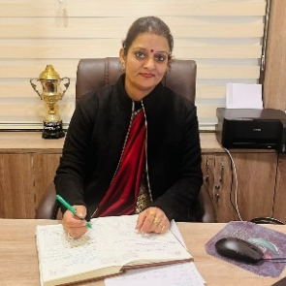
The Art of Resilience: Overcoming Academic Challenges
Penned By:- Ms. Deeksha Bhardwaj Vice Principal
Introduction
Failure; It’s a word that stings, a grade that disappoints, a moment that makes you want to give up. But what if we told you that some of the most successful students in our school have failed—sometimes spectacularly—before succeeding? Resilience isn’t about avoiding falls; it’s about learning how to rise. Here’s how your peers are doing it, and how you can too.
1. The Science of Bouncing Back
Psychologists define resilience as the ability to adapt and recover from adversity. Studies show that students who develop resilience:
✔ Perform better under pressure
✔ Are more creative problem-solvers
✔ Have higher long-term academic success
"Your brain grows most when you struggle,”. That’s when real learning happens.
2. Reframe Your Mind-set-
- Instead of "I’m bad at math" → "I haven’t mastered this yet."
View feedback as a GPS reroute, not a roadblock.
3. The 24-Hour Rule -
Allow yourself to feel disappointed—but only for one day. Then make an action plan.
4. Failure Autopsy-
Ask:
1. What exactly went wrong? (Be specific: "I didn’t understand quadratic equations" not "I’m dumb.")
2. What’s one small step I can take today to improve?
5. Wisdom from Those Who’ve Been There
"The students who worry most about failing are often the ones who care deepest. Channel that energy into curiosity."
6. Your Resilience Challenge
This month, try this:
1. Identify one academic hurdle
2. Apply one strategy from this article
3. Track your progress (improvement isn’t always linear!)
As author J.K. Rowling (who faced 12 publisher rejections) said:
"It is impossible to live without failing at something, unless you live so cautiously that you might as well not have lived at all."
At Modern Sandeepni School, we don’t expect perfection—we’re building warriors of wisdom.
Your next comeback starts today.
The Sandeepni Chronicle | April 2025

Slide 4
Sense of Responsibility: The Cornerstone of Character
From the Editor’s Desk
In a world that is constantly evolving, the need for a strong sense of responsibility has never been greater. As students, you are often reminded of your duties — towards your studies, your families, your school, and even yourselves. But what does it truly mean to be responsible?
Responsibility is more than just completing homework on time or following classroom rules. It is a mindset — a conscious decision to be accountable for one’s actions, choices, and their consequences. It is about owning up to your mistakes, fulfilling commitments, and understanding the impact you have on others and the world around us.
In school life, a sense of responsibility reflects in small but significant actions: arriving on time, respecting teachers, helping peers, taking care of school property, and giving your best in every assignment. These are the building blocks of a dependable character. When students act responsibly, they contribute to a positive learning environment where everyone feels safe, respected, and motivated.
Outside the classroom, responsibility takes a broader form. It includes being aware of our roles as citizens of a community, being kind and empathetic, standing up against wrongdoings, and making choices that reflect integrity and thoughtfulness. In today’s digital age, it also means using social media wisely, respecting privacy, and avoiding misinformation.
Developing a sense of responsibility does not happen overnight. It is nurtured through practice, guidance, and reflection. Teachers and parents play a crucial role in setting examples, but as students, you must also take the initiative to grow into individuals who can be trusted — individuals who do not wait to be told what is right but choose to do it anyway.
I believe that promoting responsibility among students is just as important as celebrating achievements. Let us all strive to be the kind of individuals who do not simply chase success, but build it on the solid foundation of responsibility.
After all, true leaders are not just those who reach the top, but those who uplift others with their sense of duty, honesty, and unwavering commitment.
The Sandeepni Chronicle | April 2025

Slide 5
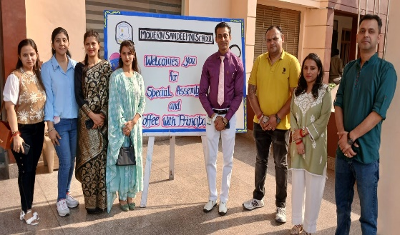
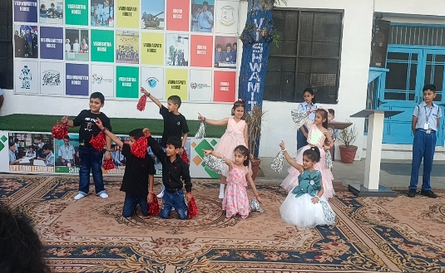
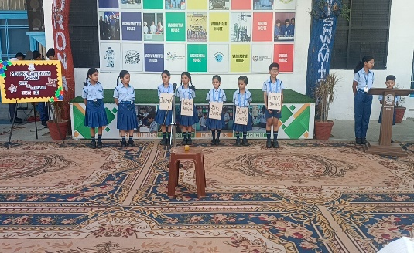
Expressions and Connections: Grade I’s Coffee Meet with the Principal
Article By:- Ms. Komal
The vibrant and enthusiastic students of Grade I hosted a delightful event titled “Coffee with Principal”, which turned out to be a memorable and heartwarming experience. The event showcased the talents and creativity of the young learners through a series of engaging activities, making it a joyful occasion for the students, parents, and the Principal.
The event was gracefully hosted by Atharv, who welcomed everyone with confidence and charm. The program began on a spiritual note with a beautiful Shlok recitation by Meeral, Parnika, and Vaaris, setting a calm and positive tone. This was followed by an inspiring thought for the day by Kanav, which reflected the wisdom of young minds.
Agastya amazed the audience with interesting and lesser-known facts that left everyone intrigued. A lively and meaningful role play was performed by Hrida, Ashwikaa, Ivaana, Keerat, Vanya, Namish, and Nimrat, who conveyed important messages with great enthusiasm and expression. Shivanya recited a lovely poem, capturing hearts with her sweet voice and confident presentation.
The energy reached its peak with a joyful dance performance by Rabia, Eshani, Prizleen, Saanvi, Gaurav, Aarish, Shanaye, and Prikshit, leaving the audience clapping and cheering.
Parents were also given an opportunity to share their views with the Principal. They expressed their appreciation for the school’s efforts, praised the students’ performances, and shared positive feedback about the nurturing environment provided to their children.
Overall, the event was a delightful celebration of talent, learning, and strong school-home collaboration.
The Sandeepni Chronicle | April 2025

Slide 6
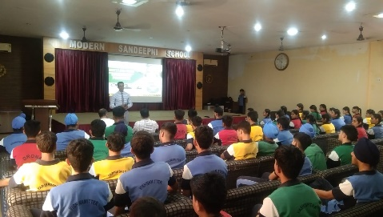
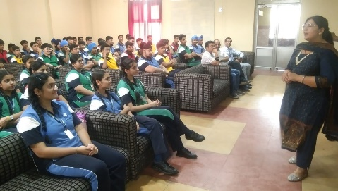
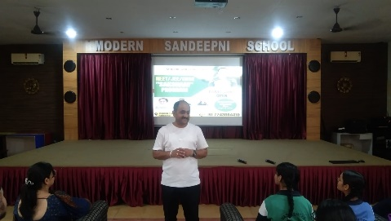
Unlocking Futures: NEET & JEE Pathways Explored!
Article By:- Mr. Vinay Kumar
Modern Sandeepni School organized a highly informative Career Awareness Seminar on May 21st from 10:00 AM to 11:00 AM in the school auditorium. The event aimed to guide students—particularly those in Class X—regarding career paths after school, with special emphasis on NEET and JEE.
The seminar featured distinguished experts in the field of career counselling: Mr. Sandeep Sharma, Mr. Lalit Kishore, and Mrs. Sonali Sharma. They shared deep insights on preparation strategies, entrance exam patterns, and the evolving landscape of competitive examinations like NEET (for medical aspirants) and JEE (for engineering aspirants). The experts also addressed students' queries and discussed how to balance board preparation with competitive exams effectively.
The school principal, Dr. Neeraj Mohan Puri, also graced the occasion and contributed significantly to the discussion. In his address, he emphasized the importance of aligning career choices with students' interests and strengths. He encouraged students to stay focused, remain confident, and make informed decisions rather than being swayed by societal pressure or trends.
The event concluded with a powerful message from Dr. Puri, reminding students that "the right choice is the one that brings both passion and purpose into your life." The seminar left students feeling motivated and better equipped to plan their academic journey after Class XII.
The Sandeepni Chronicle | April 2025

Slide 7
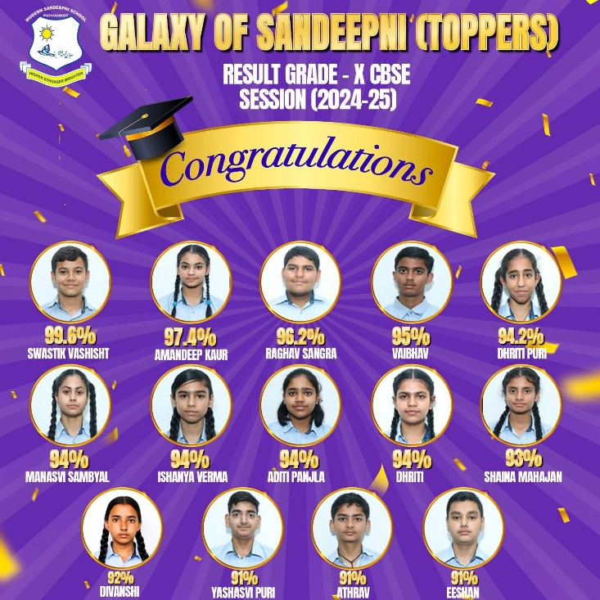
A Triumph of Excellence: Grade 10 Students Set New Benchmark
Article By:- Mr. Vikram
The Grade 10 results this year have been outstanding, reflecting the hard work, dedication, and academic excellence of our students. The overall performance of the batch has been brilliant, with a significant number of students achieving exceptional scores.
Leading the cohort is Swastik, who secured the highest marks with an impressive 99.8%, setting a remarkable standard of achievement. He is followed by Amandeep, who earned the second highest score of 97.4%, and Raghav Sangra, who stood third with 96.2%. These top scorers have not only brought pride to their families but have also inspired their peers with their commitment and discipline.
In addition to the top three achievers, more than 15 students scored above 90%, a testament to the consistent efforts of both students and teachers throughout the academic year. These results highlight the school's focus on academic excellence and the effectiveness of its teaching methods.
The school management and Principal extended their heartfelt congratulations to all students for their remarkable success. They also appreciated the sincere efforts of the teaching staff and the unwavering support of parents, which played a crucial role in shaping this success story.
The school takes immense pride in the accomplishments of its students and looks forward to nurturing many more such achievers in the future. Congratulations to all the students of Grade 10 for their stellar performance and for upholding the school’s legacy of excellence.
The Sandeepni Chronicle | April 2025

Slide 8
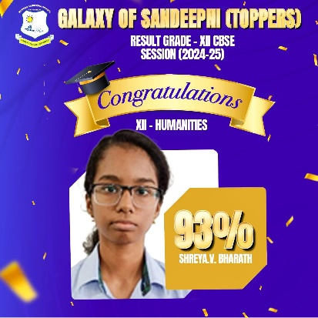
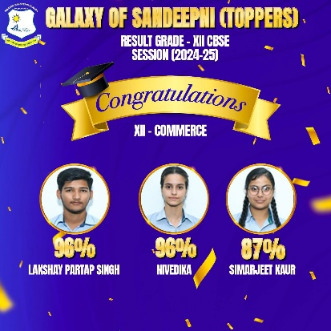
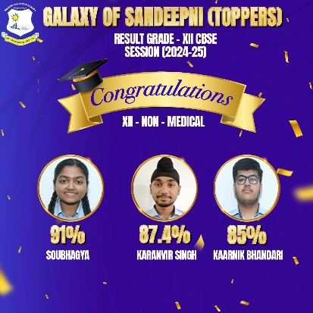
Champions of Excellence: Grade 12th Result Unveiled
Article By:- Ms. Mohnia Pathania
The school proudly announces the outstanding performance of its Grade 12 students in the CBSE Examination 2024–25. The results reflect the students' hard work, dedication, and academic excellence across all three streams — Commerce, Humanities, and Science.
In the Commerce Stream, Lakshay emerged as the top performer, securing an impressive 96% and thereby bagging the first position. Nivedika followed closely and secured the second position, showcasing exceptional academic ability and commitment.
In the Humanities Stream, Shreya V. Bharath brought immense pride to the school and her parents by scoring 93%, a commendable achievement that highlights her determination and consistent efforts.
In the Science Stream, Soubhagya Mahajan earned accolades with a remarkable 91%, marking her as one of the top achievers in the stream.
The results were officially announced by Principal Dr. Neeraj Mohan Puri, who congratulated all Grade 12 students for their achievements and extended his heartfelt best wishes for their future endeavours. He emphasised the importance of perseverance and lifelong learning as the students embark on new journeys ahead.
The school’s Honourable Chairman, Captain Salil Mahajan, appreciated the relentless hard work of both students and teachers. He acknowledged the unwavering dedication of the faculty and the resilience of the students in maintaining academic excellence.
The school community stands proud of the accomplishments of the Class of 2024–25 and wishes them continued success in all their future pursuits.
The Sandeepni Chronicle | April 2025

Slide 9
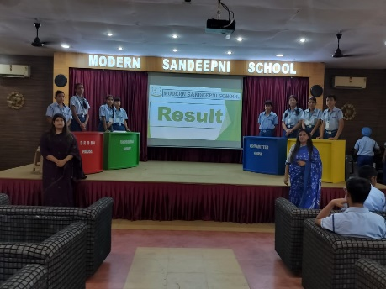
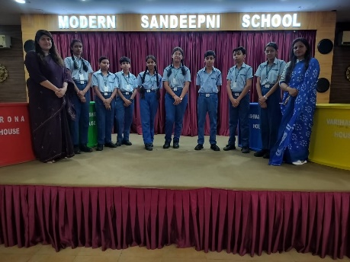
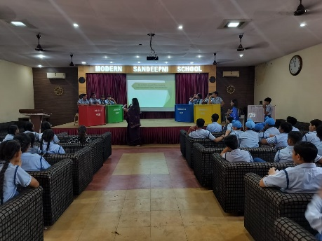
INTER-HOUSE QUIZO’ MANIA ENVIRONMENTAL ISSUES
Article By:- Ms. Bharti
School is pleased to announce that Modern Sandeepni School recently organized an engaging Inter-House Quiz Competition on Environment and Forests Awareness Program for Class VIII students on 28th April 2025. This special event aims to educate and inspire students to care for nature, protect our forests, and spread awareness about environmental issues.
Through various activities and games, students not only enjoyed themselves but also helped spread important knowledge about protecting our environment and saving forests. We are proud of their efforts to learn and share valuable messages with others.
Students from all four houses will take part in various activities and games that promote learning in a fun and meaningful way. We believe this program will help students understand the importance of the environment and encourage them to take positive action. Students competed house-wise, and the event witnessed an exciting display of teamwork, quick thinking, and awareness. The final results were as follows:
1st Position: Vishwamitter House
2nd Position: Vashishtha House
3rd Position: Varishaspati House
Participation: Drona House
We would like to thank our dedicated teachers— Ms Bharti, and Ms. Shaina—for guiding and supporting the students in preparing for this event. Their efforts in organizing and motivating the children are truly appreciated.
The Sandeepni Chronicle | April 2025

Slide 10
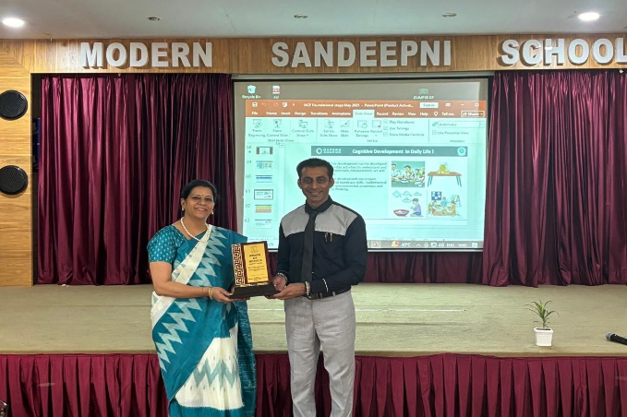
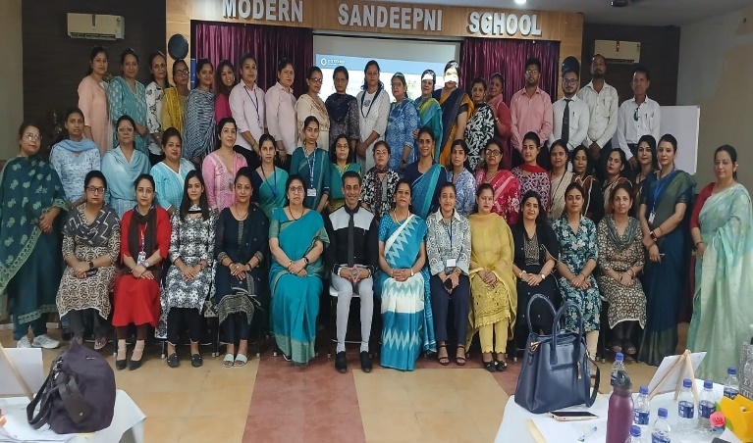
Empowering Educators for the Foundation Stage: A Capacity Building Initiative
Article By:- Ms. Nisha
A Capacity Building Programme (CBP) focusing on the Foundation Stage was successfully conducted on 19th May 2025, aiming to enhance the teaching-learning process at the foundational level and equip educators with modern pedagogical strategies.
The programme was graced by two distinguished educationists—Ms. Rashmi Ahluwalia, Principal of MCS School, Pathankot, and Ms. Upma Mahajan, Principal of Laurels International School, Batala. Their combined experience and in-depth knowledge brought valuable insights to the participants, making the session both engaging and enriching.
Ms.Rashmi Ahluwalia emphasized the importance of early childhood education and how it lays the groundwork for a child’s lifelong learning. She elaborated on creating joyful and inclusive classroom environments that nurture curiosity, creativity, and holistic development.
Ms.Upma Mahajan highlighted various strategies aligned with the National Education Policy (NEP) 2020 for the foundational stage. She discussed the integration of play-based, activity-based, and discovery-based learning approaches, which form the core of early education.
Throughout the session, teachers actively participated in discussions, group activities, and reflections. The resource persons also shared real-life classroom examples and provided practical tips to make foundational learning more impactful.
The programme concluded with a Q&A session, allowing teachers to clarify doubts and share their experiences. It was a highly fruitful and interactive session that motivated educators to apply the new techniques in their classrooms.
In conclusion, the CBP proved to be a valuable initiative in empowering teachers with innovative methods for teaching young learners and strengthening the foundation of education in schools.
The Sandeepni Chronicle | April 2025

Slide 11
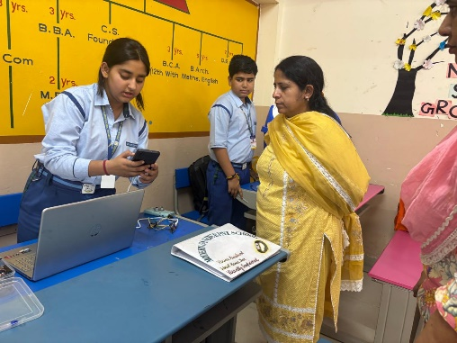
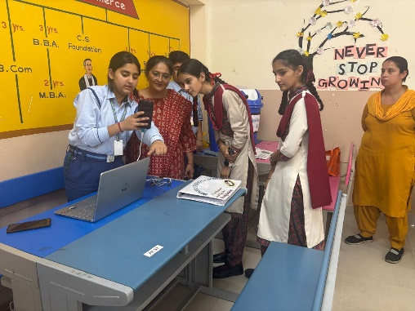
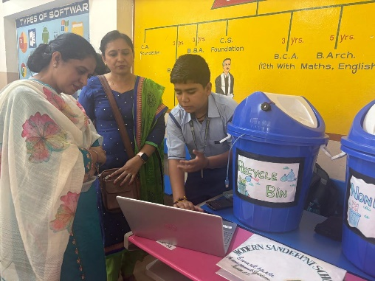
Innovators in Action: A Proud Moment at the DLEPC 2024-25
Article By:- Mr. Pulkit Mahajan
School is thrilled to share the exceptional achievement of two bright minds from our school who made us immensely proud at the District Level Exhibition and Project Competition (DLEPC) 2024-25, held at School of Excellence (SOE), Town Hall, Amritsar.
Vaanya, a student of Grade X Peace, and Aditya Mehra, from Grade X Loyal, represented our school with outstanding innovation and dedication. Competing among the finest young innovators in the district, their projects not only demonstrated technical excellence but also reflected a deep sense of empathy and social responsibility.
Vaanya presented her project — a Voice Assistant Wrist Band specially designed for the visually impaired. The device aims to support individuals in navigating their daily lives more independently through voice commands and audio feedback. Her innovation was lauded for its practicality, user-friendly design, and the potential to significantly improve the quality of life for those with visual challenges.
Aditya Mehra showcased his project — a Smart AI-Powered Waste Management System. His system uses artificial intelligence to detect, categorize, and manage waste efficiently. It is designed to promote environmental sustainability by reducing manual effort and encouraging proper waste segregation and recycling practices. Judges praised the project for its futuristic vision and real-world applicability.
Both students impressed the panel with their presentations, innovative thinking, and clear problem-solving approaches. Their participation reflected the school’s commitment to nurturing critical thinking, creativity, and scientific temperament among students.
In conclusion, Vaanya and Aditya’s success at the DLEPC is a testament to their hard work, the guidance of their mentors, and the encouraging academic environment of our institution. They have truly lived up to the spirit of "Innovators in Action!"
The Sandeepni Chronicle | April 2025

Slide 12
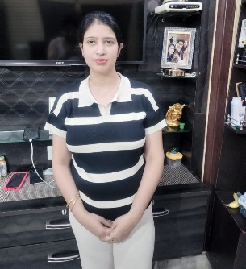
Parent’s Pen
How to Stay Involved in Your Child’s School Life
Staying involved in your child’s school life is one of the most impactful ways to support their academic and emotional development. Here are some simple yet effective ways to stay connected:
1. Communicate Regularly with Teachers
Establish a positive relationship with your child’s teachers. Attend parent-teacher meetings, and don’t hesitate to reach out through emails or school apps. Regular communication helps you stay updated on your child’s progress and any concerns.
2. Participate in School Events
Make time to attend school functions, exhibitions, and performances. Whether it's a special assembly, annual day, or class presentation, your presence shows your child that their efforts are valued.
3. Support Learning at Home
Create a calm and organized space for homework and study. Encourage reading, curiosity, and independent thinking. Ask about what they learned each day and engage in meaningful discussions.
4. Join the Parent Community
Be part of the PTA or parent volunteer groups. This not only keeps you informed but also strengthens the parent-school partnership.
5. Encourage Responsibility
Let your child take the lead in managing assignments, projects, and schedules. Offer support, but also trust them to take ownership of their learning.
Conclusion
Active involvement doesn’t mean constant oversight—it means showing interest, being available, and offering encouragement. When children see that their parents are genuinely engaged, it boosts their confidence and motivation to do well. Your involvement today helps shape a positive, lasting attitude toward school and learning.
Shikha Mahajan
Proud Parent of Jyena Mahajan ( V Loyal )
The Sandeepni Chronicle | April 2025

Slide 13
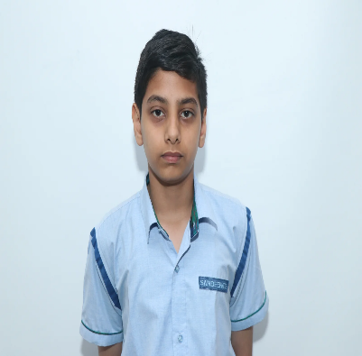
Book Review
Wings of Fire by Dr. A.P.J. Abdul Kalam
Reviewed by:- Arnav Gupta (X Loyal)
Introduction "Wings of Fire" is an inspiring autobiography of Dr. A.P.J. Abdul Kalam, India’s former President and a renowned scientist. Co-authored with Arun Tiwari, the book traces Kalam’s journey from a humble background in Rameswaram to becoming the “Missile Man of India.”
Content Summary The book is divided into four parts – Orientation, Creation, Propitiation, and Contemplation – and provides insights into his early life, education, struggles, scientific achievements, and spiritual growth. It highlights his key contributions to India’s space and missile programs, especially his work with ISRO and DRDO.
Themes and Message At its heart, Wings of Fire is a tale of resilience, hard work, and patriotism. It emphasizes the power of dreams and the importance of persistence. Kalam’s humility and devotion to India shine throughout the narrative.
Why It Inspires The book is highly motivating for students and young readers. It shows how even a boy from a small town, with dedication and vision, can rise to national prominence. Kalam’s optimism, leadership, and values make this a must-read.
Conclusion Wings of Fire is not just an autobiography – it's a guide for anyone who dares to dream and work hard. A truly uplifting and patriotic read.
The Sandeepni Chronicle | April 2025

Slide 14
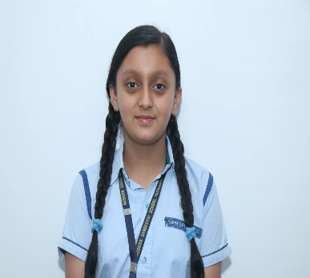
The Calm Ocean
By:- Deevisha (VIII-Peace)
The calm ocean is a magical sight, Glittering softly in the morning light. Its waves gently kiss the sandy shore, Whispering stories of legends and more.
The blue water stretches far and wide, A peaceful place where dreams can glide. Seagulls fly and sing above, Filling the air with songs of love.
The ocean breeze is cool and sweet, A perfect calm where sky and water meet. Shells and pebbles line the sand, Nature’s treasures from a distant land.
At sunset, the ocean turns to gold, A beautiful story silently told. The calm ocean teaches us to be still, To find peace within, beyond all thrill.
When life feels fast and days are long, The calm ocean’s quiet is a soothing song. It reminds us to breathe, to pause, to see, The simple beauty of being free.
So whenever you feel lost or alone, Think of the calm ocean, its gentle tone. Its endless peace and soothing grace, A special, quiet, and loving place.
The Sandeepni Chronicle | April 2025

Slide 15
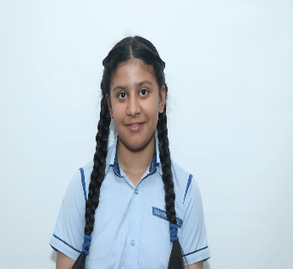
डिजिटल युग में शिक्षा
By:- Vandita ( IX- Peace)
आज के समय में शिक्षा का स्वरूप पूरी तरह बदल गया है। डिजिटल युग ने शिक्षा के क्षेत्र में क्रांतिकारी बदलाव लाए हैं, जिससे सीखने का तरीका और भी आसान और प्रभावशाली बन गया है।
डिजिटल शिक्षा क्या है?
डिजिटल शिक्षा का मतलब है कंप्यूटर, इंटरनेट, मोबाइल और अन्य तकनीकी उपकरणों का उपयोग करके शिक्षा प्राप्त करना। इसमें ऑनलाइन क्लास, डिजिटल किताबें, वीडियो लेक्चर, और विभिन्न शैक्षिक ऐप्स शामिल हैं।
डिजिटल शिक्षा के फायदे
डिजिटल शिक्षा से विद्यार्थी कहीं भी और कभी भी पढ़ सकते हैं। इससे समय और स्थान की बाधाएं खत्म हो जाती हैं। छात्र अपनी गति से पढ़ाई कर सकते हैं और कठिन विषयों को भी आसानी से समझ सकते हैं। इसके अलावा, डिजिटल शिक्षा में इंटरेक्टिव वीडियो और ग्राफिक्स की मदद से पढ़ाई मजेदार बन जाती है।
डिजिटल शिक्षा के कुछ नुकसान
हालांकि डिजिटल शिक्षा के फायदे अधिक हैं, लेकिन इसके कुछ नुकसान भी हैं। लगातार कंप्यूटर और मोबाइल स्क्रीन के सामने बैठने से आंखों पर बुरा असर पड़ता है। साथ ही, इंटरनेट पर गलत जानकारी मिलने का खतरा भी रहता है। इसलिए सही मार्गदर्शन और संतुलित उपयोग आवश्यक है।
निष्कर्ष
डिजिटल युग में शिक्षा ने सीखने के नए अवसर प्रदान किए हैं। शिक्षक और विद्यार्थी दोनों को इस तकनीक का सही उपयोग करना चाहिए ताकि शिक्षा का स्तर सुधरे और सभी को लाभ मिले। डिजिटल शिक्षा ने शिक्षा को अधिक सुलभ, सरल और प्रभावी बना दिया है, जिससे भविष्य की पीढ़ी बेहतर तरीके से तैयार हो सकती है।
The Sandeepni Chronicle | April 2025

Slide 16
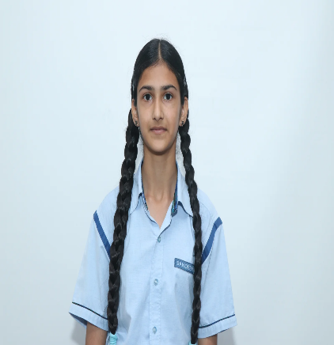
ਸਿਹਤਮੰਦ ਜੀਵਨ ਲਈ ਸਿਹਤਮੰਦ ਖੁਰਾਕ
By:- Varnika Kaur ( X-Loyal)
ਸਿਹਤਮੰਦ ਜੀਵਨ ਜਿਉਣ ਲਈ ਸਿਹਤਮੰਦ ਖੁਰਾਕ ਬਹੁਤ ਜਰੂਰੀ ਹੈ। ਸਰੀਰ ਨੂੰ ਤੰਦਰੁਸਤ ਅਤੇ ਤਾਕਤਵਰ ਬਣਾਉਣ ਲਈ ਸਹੀ ਅਤੇ ਪੋਸ਼ਣ ਭਰੀ ਖੁਰਾਕ ਲੈਣਾ ਬਹੁਤ ਮਹੱਤਵਪੂਰਨ ਹੁੰਦਾ ਹੈ। ਸਿਹਤਮੰਦ ਖੁਰਾਕ ਉਹ ਹੁੰਦੀ ਹੈ ਜਿਸ ਵਿੱਚ ਸਾਡੇ ਸਰੀਰ ਲਈ ਜ਼ਰੂਰੀ ਸਾਰੇ ਪੋਸ਼ਕ ਤੱਤ ਸ਼ਾਮਿਲ ਹੋਣ, ਜਿਵੇਂ ਕਿ ਪ੍ਰੋਟੀਨ, ਕਾਰਬੋਹਾਈਡ੍ਰੇਟ, ਵਿੱਟਾਮਿਨ, ਮਿਨਰਲ, ਫਾਈਬਰ ਅਤੇ ਸਿਹਤਮੰਦ ਫੈਟ।
ਸਿਹਤਮੰਦ ਖੁਰਾਕ ਵਿੱਚ ਸਬਜ਼ੀਆਂ, ਫਲ, ਅਨਾਜ, ਦਾਲਾਂ, ਦੁੱਧ, ਦਹੀਂ ਅਤੇ ਨਟਸ ਵਰਗੀਆਂ ਚੀਜ਼ਾਂ ਸ਼ਾਮਿਲ ਹੁੰਦੀਆਂ ਹਨ। ਸਬਜ਼ੀਆਂ ਅਤੇ ਫਲਾਂ ਸਾਡੇ ਸਰੀਰ ਨੂੰ ਵਿੱਟਾਮਿਨ ਅਤੇ ਮਿਨਰਲ ਦੇਣ ਵਿੱਚ ਮਦਦ ਕਰਦੀਆਂ ਹਨ ਜੋ ਸਾਡੇ ਰੋਗ-ਪ੍ਰਤੀਰੋਧਕ ਤੰਤਰ ਨੂੰ ਮਜ਼ਬੂਤ ਬਣਾਉਂਦੇ ਹਨ। ਦਾਲਾਂ ਅਤੇ ਅਨਾਜ ਪ੍ਰੋਟੀਨ ਅਤੇ ਕਾਰਬੋਹਾਈਡ੍ਰੇਟ ਦੇ ਸਰੋਤ ਹਨ, ਜੋ ਸਾਡੇ ਸਰੀਰ ਨੂੰ ਤਾਕਤ ਅਤੇ ਉਰਜਾ ਦਿੰਦੇ ਹਨ। ਦੁੱਧ ਅਤੇ ਦੁੱਧ ਤੋਂ ਬਣੀ ਚੀਜ਼ਾਂ ਹੱਡੀਆਂ ਨੂੰ ਮਜ਼ਬੂਤ ਬਣਾਉਂਦੀਆਂ ਹਨ ਕਿਉਂਕਿ ਇਹ ਕੈਲਸ਼ੀਅਮ ਦਾ ਵਧੀਆ ਸਰੋਤ ਹੁੰਦੀਆਂ ਹਨ।
ਸਿਹਤਮੰਦ ਜੀਵਨ ਲਈ ਸਿਰਫ ਖਾਣਾ ਹੀ ਨਹੀਂ, ਸਹੀ ਸਮੇਂ ‘ਤੇ ਖਾਣਾ ਵੀ ਜ਼ਰੂਰੀ ਹੈ। ਸਵੇਰੇ ਦਾ ਨਾਸ਼ਤਾ ਛੱਡਣਾ ਜਾਂ ਬਹੁਤ ਜ਼ਿਆਦਾ ਤੇਲ ਅਤੇ ਮਿੱਠਾ ਖਾਣਾ ਸਿਹਤ ਲਈ ਨੁਕਸਾਨਦਾਇਕ ਹੁੰਦਾ ਹੈ। ਅਸੀਂ ਹਰ ਦਿਨ ਤਾਜ਼ਾ ਅਤੇ ਪੋਸ਼ਕ ਤੱਤਾਂ ਨਾਲ ਭਰਪੂਰ ਖਾਣਾ ਖਾਣਾ ਚਾਹੀਦਾ ਹੈ। ਇਸ ਤੋਂ ਇਲਾਵਾ, ਜੰਕ ਫੂਡ, ਜਿਵੇਂ ਕਿ ਚਿਪਸ, ਕੋਲਡ ਡ੍ਰਿੰਕਸ, ਬਰਗਰ ਅਤੇ ਫ੍ਰਾਇਡ ਫੂਡ ਤੋਂ ਦੂਰ ਰਹਿਣਾ ਚਾਹੀਦਾ ਹੈ, ਕਿਉਂਕਿ ਇਹ ਸਰੀਰ ਵਿੱਚ ਕਈ ਬਿਮਾਰੀਆਂ ਜਿਵੇਂ ਕਿ ਮੋਟਾਪਾ, ਸ਼ੂਗਰ ਅਤੇ ਹਾਰਟ ਦੀਆਂ ਬਿਮਾਰੀਆਂ ਪੈਦਾ ਕਰ ਸਕਦੇ ਹਨ।
ਸਿਹਤਮੰਦ ਜੀਵਨ ਲਈ ਪਾਣੀ ਪੀਣਾ ਵੀ ਬਹੁਤ ਜਰੂਰੀ ਹੈ। ਦਿਨ ਵਿੱਚ ਘੱਟੋ-ਘੱਟ 8 ਗਲਾਸ ਪਾਣੀ ਪੀਣਾ ਚਾਹੀਦਾ ਹੈ ਤਾਂ ਜੋ ਸਾਡਾ ਸਰੀਰ ਹਾਈਡ੍ਰੇਟ ਰਹੇ ਅਤੇ ਸਾਰੇ ਜ਼ਹਿਰੀਲੇ ਤੱਤ ਸਰੀਰ ਤੋਂ ਨਿਕਲ ਜਾਣ। ਪਾਣੀ ਸਾਡੀ ਹਜ਼ਮਤ ਨੂੰ ਵੀ ਮਜ਼ਬੂਤ ਕਰਦਾ ਹੈ ਅਤੇ ਤਵਚਾ ਨੂੰ ਚਮਕਦਾਰ ਬਣਾਉਂਦਾ ਹੈ।
ਸਿਹਤਮੰਦ ਖੁਰਾਕ ਨਾਲ ਸਾਡਾ ਮਨੋਬਲ ਵਧਦਾ ਹੈ, ਸਾਡਾ ਸਰੀਰ ਤੰਦਰੁਸਤ ਰਹਿੰਦਾ ਹੈ ਅਤੇ ਅਸੀਂ ਆਪਣੇ ਦਿਨ-ਚਰਿਆ ਦੇ ਕੰਮਾਂ ਵਿੱਚ ਬਿਹਤਰ ਕਾਰਗੁਜ਼ਾਰੀ ਕਰ ਸਕਦੇ ਹਾਂ। ਇਸ ਲਈ, ਸਾਨੂੰ ਆਪਣੀ ਖੁਰਾਕ ਦਾ ਖਿਆਲ ਰੱਖਣਾ ਚਾਹੀਦਾ ਹੈ, ਤਾਜ਼ਾ ਅਤੇ ਪੋਸ਼ਕ ਚੀਜ਼ਾਂ ਖਾਣੀਆਂ ਚਾਹੀਦੀਆਂ ਹਨ ਅਤੇ ਬੁਰੇ ਆਦਤਾਂ ਤੋਂ ਬਚਣਾ ਚਾਹੀਦਾ ਹੈ।
ਸਿਹਤਮੰਦ ਜੀਵਨ ਲਈ ਸਿਹਤਮੰਦ ਖੁਰਾਕ ਨਾਂ ਸਿਰਫ ਸਰੀਰਕ ਤੰਦਰੁਸਤੀ ਲਈ ਜਰੂਰੀ ਹੈ, ਸਗੋਂ ਇਹ ਸਾਡੇ ਮਨ ਅਤੇ ਦਿਮਾਗ ਨੂੰ ਵੀ ਚੰਗਾ ਰੱਖਦੀ ਹੈ। ਇਸ ਲਈ ਸਾਰੇ ਲੋਕਾਂ ਨੂੰ ਆਪਣੀ ਖੁਰਾਕ ‘ਤੇ ਧਿਆਨ ਦੇਣਾ ਚਾਹੀਦਾ ਹੈ ਅਤੇ ਸਿਹਤਮੰਦ ਜੀਵਨ ਬਿਤਾਉਣ ਦੀ ਕੋਸ਼ਿਸ਼ ਕਰਨੀ ਚਾਹੀਦੀ ਹੈ।
The Sandeepni Chronicle | April 2025

Slide 17
By Art & Craft Department
The Sandeepni Chronicle | April 2025

Slide 18
The Sandeepni Chronicle | April 2025

